Slide 1
Ditch No. 2152 Branch 9 Brush Creek
Ditch Viewing May 30, 2024 at 9:30 A.M.
Commissioners Office
Administration Building
Wauseon, Ohio

Slide 2
Branch 9 Brush Creek Ohio Turnpike to County Road H
Upper Terminus of Ditch No. 2152
Section 1, T-7-N, R-5-E, Franklin Township

Slide 4
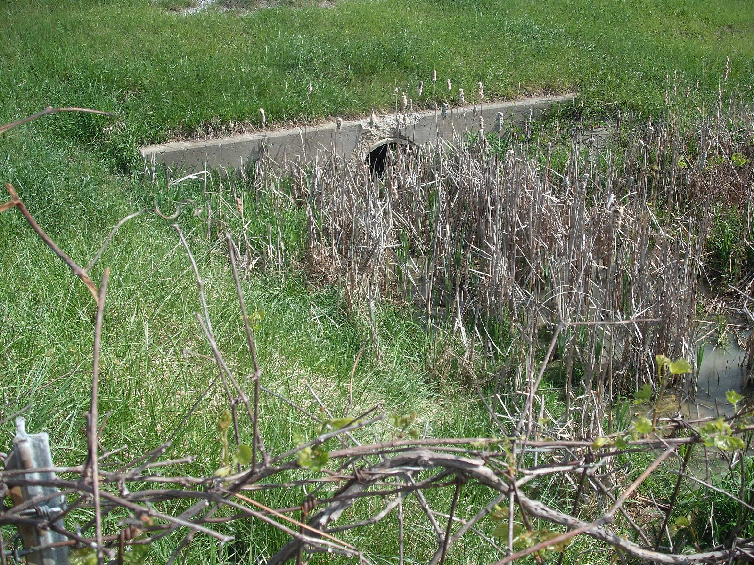

Slide 5
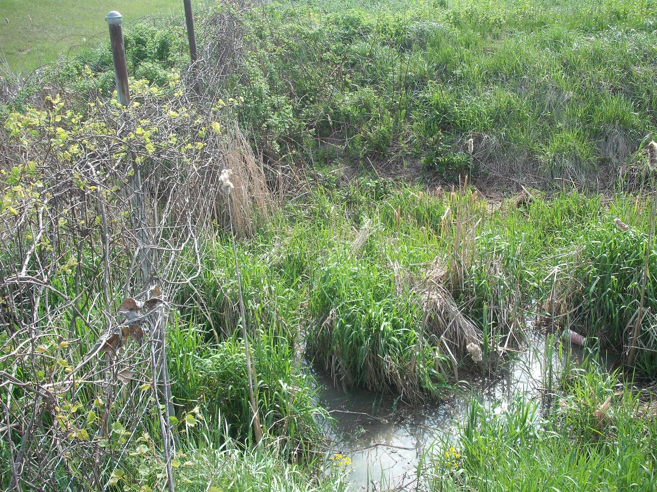

Slide 6
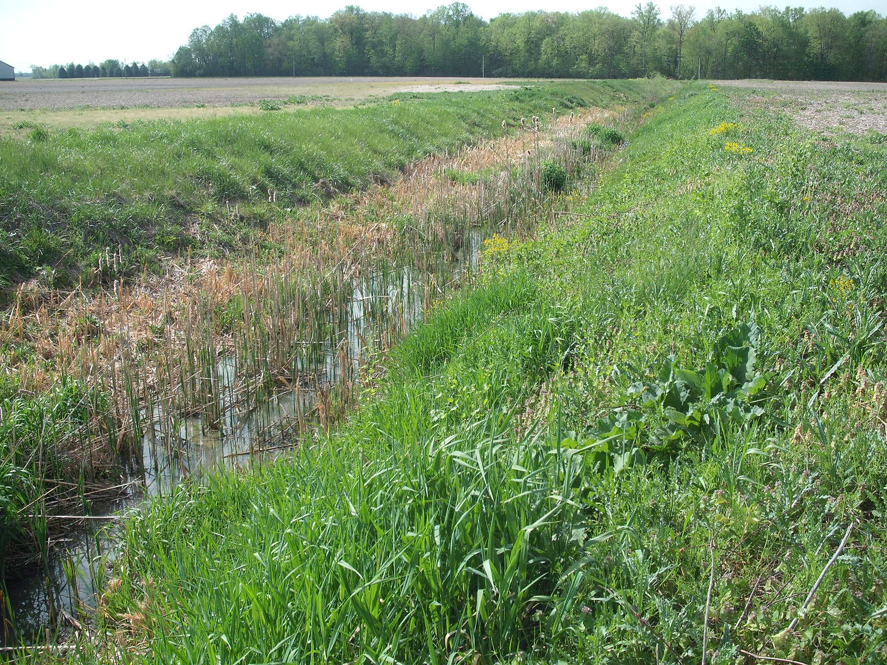

Slide 7
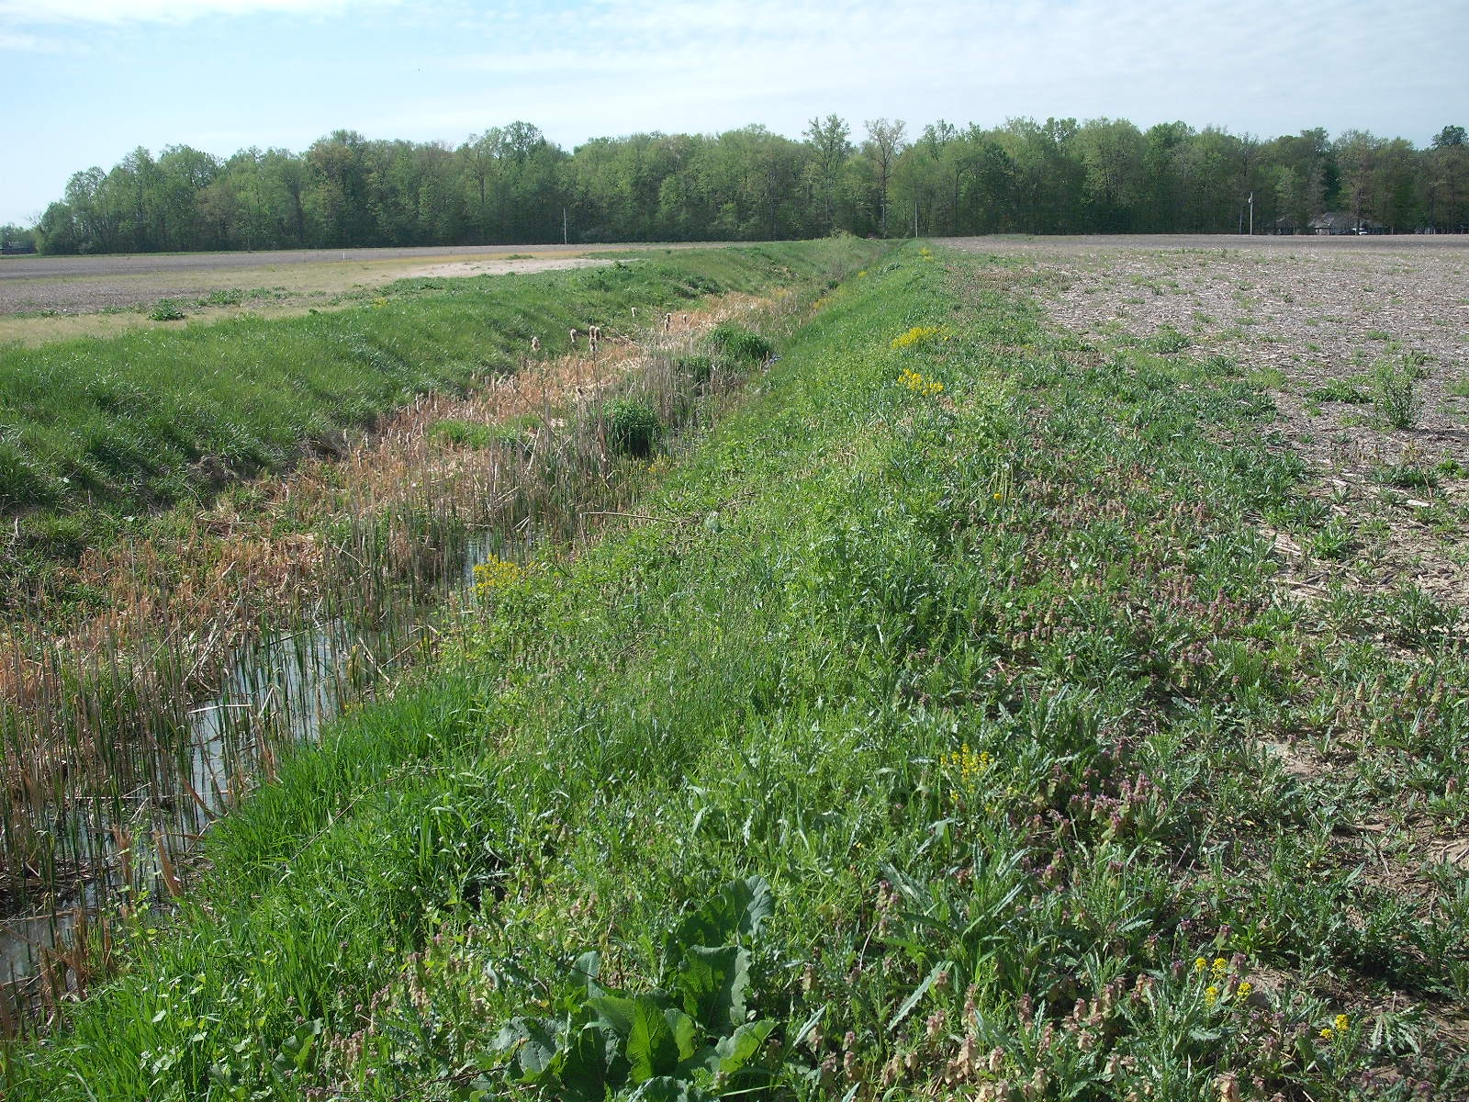

Slide 8
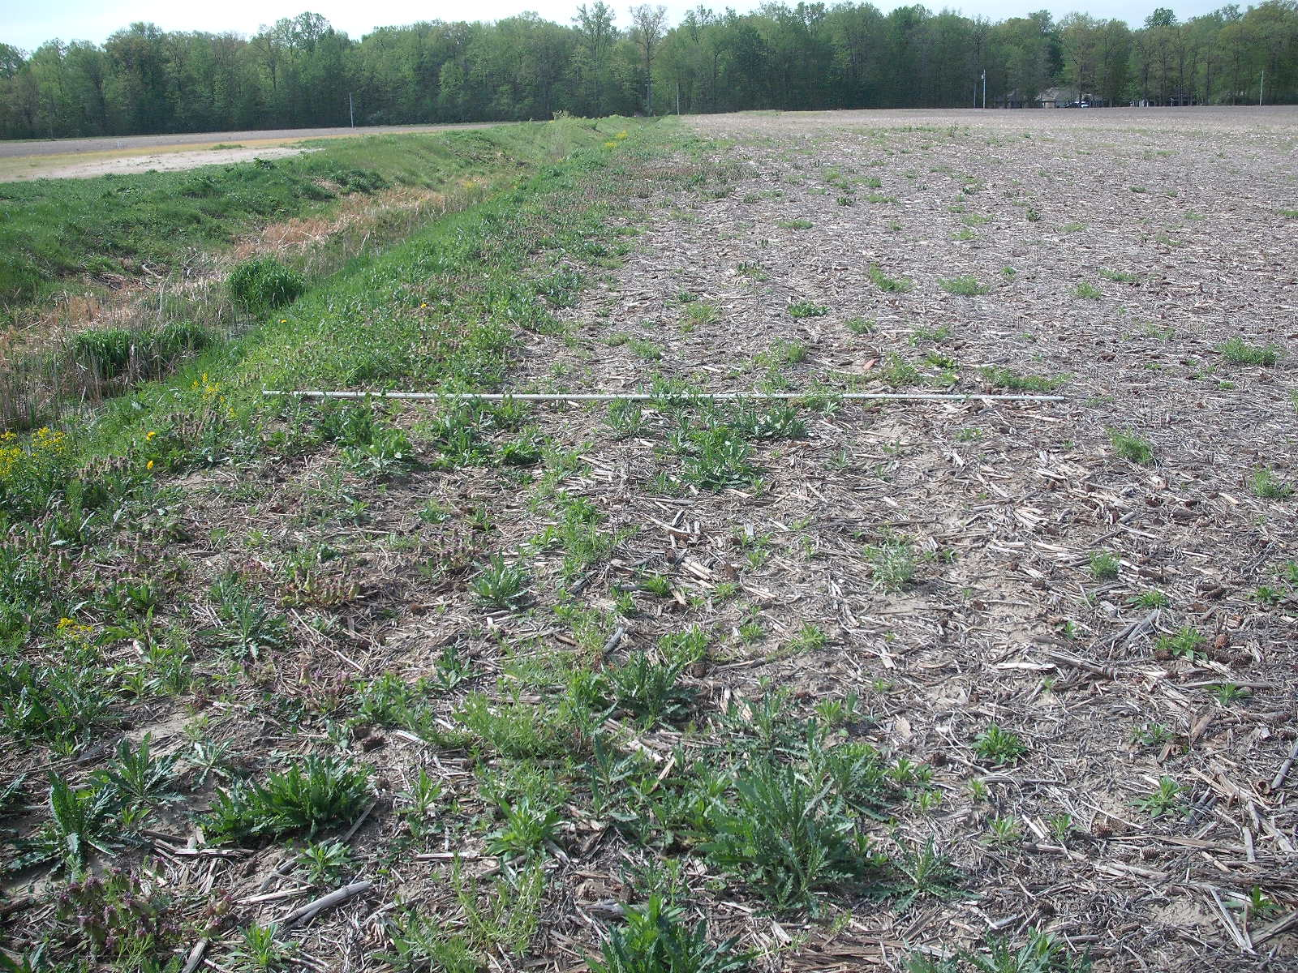

Slide 9
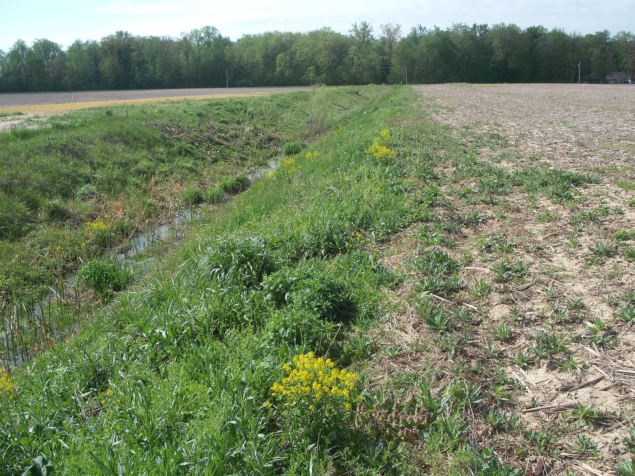

Slide 10
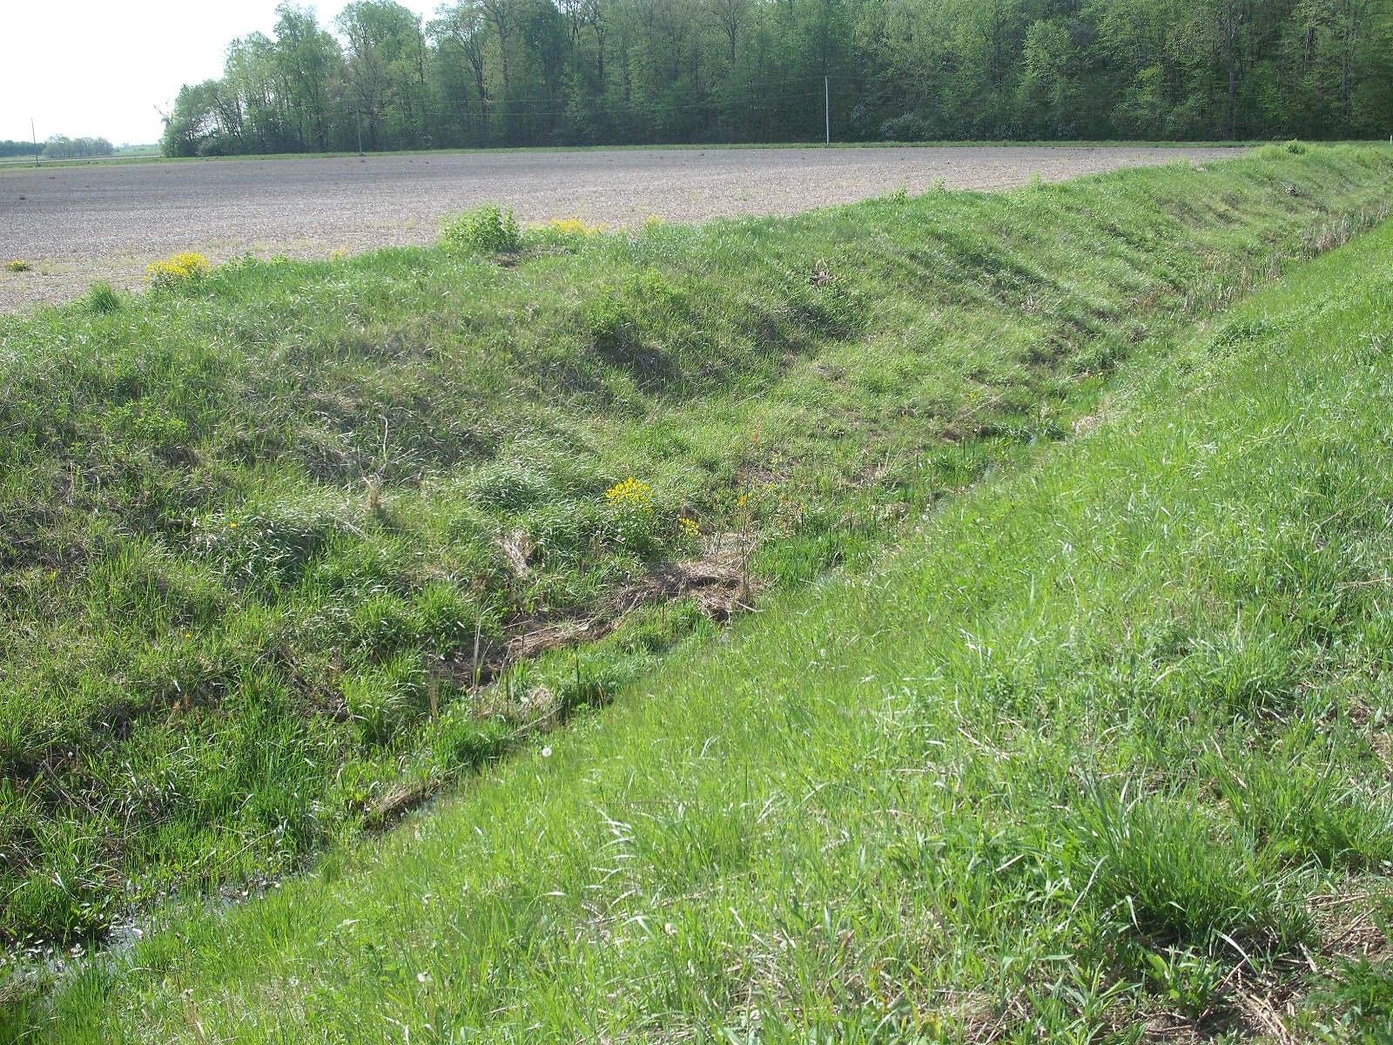

Slide 11
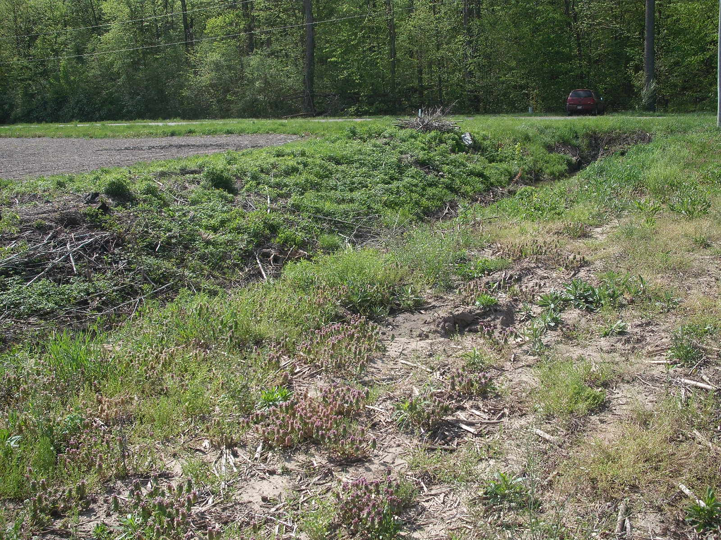

Slide 12
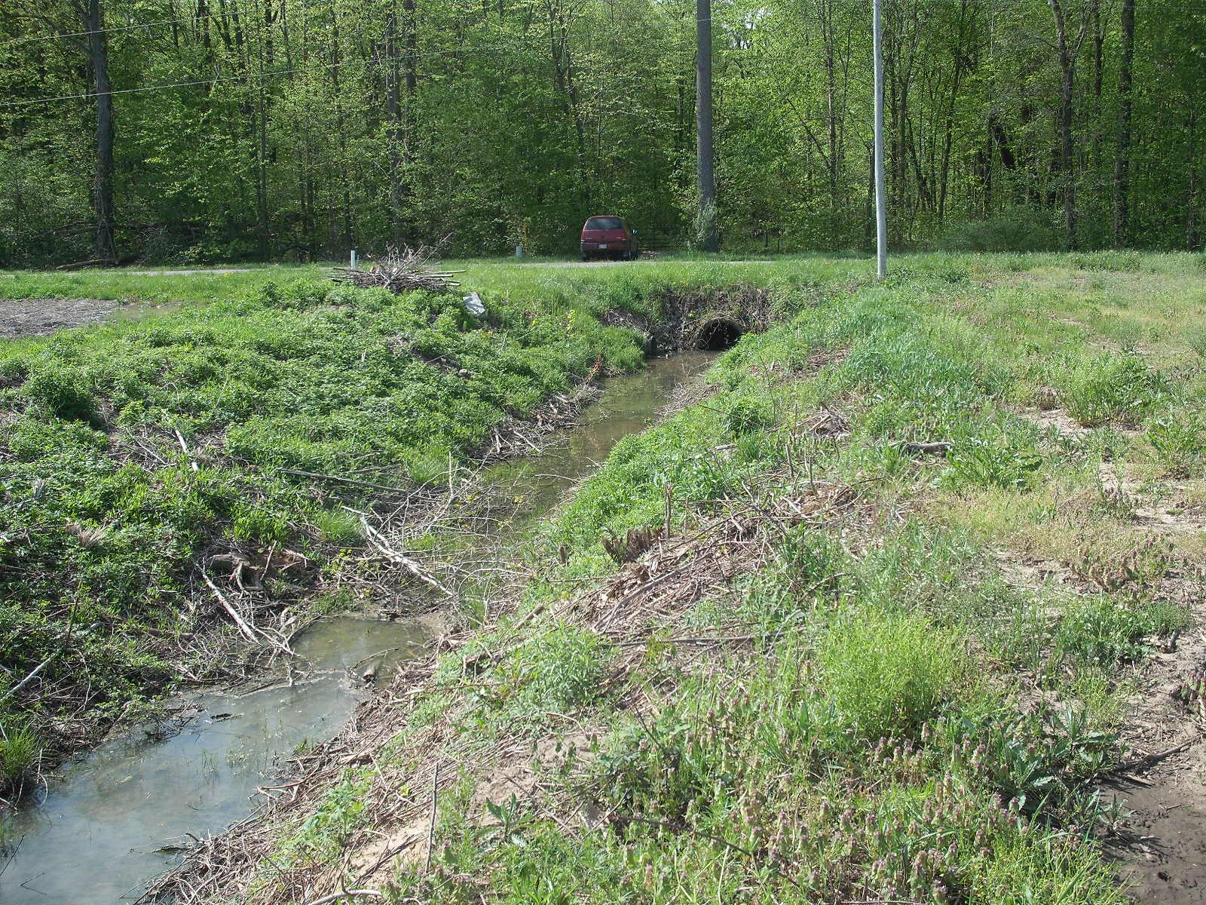

Slide 13
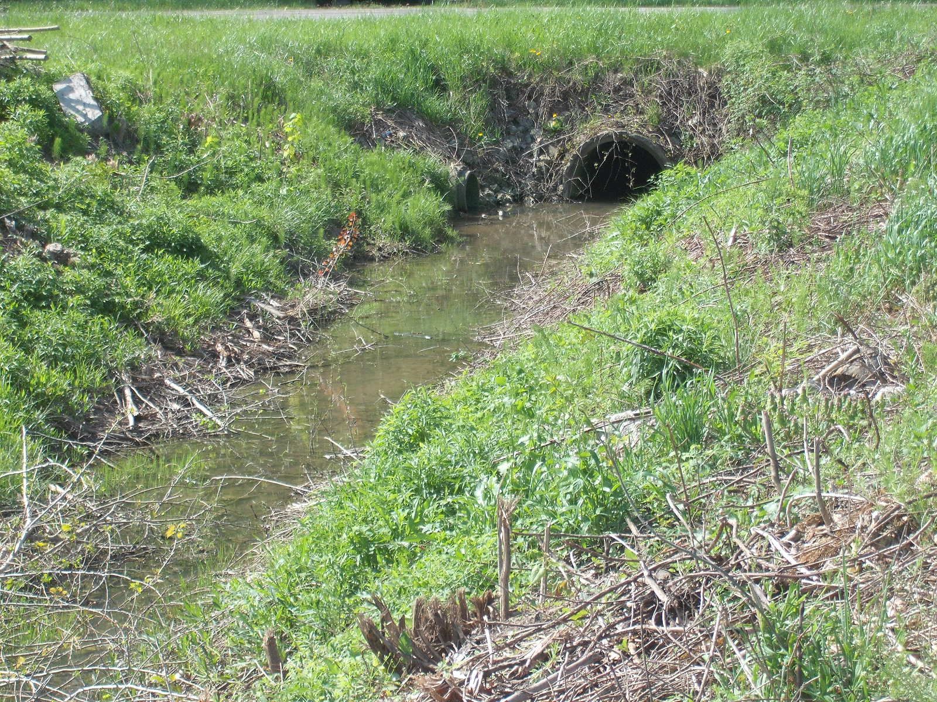

Slide 14
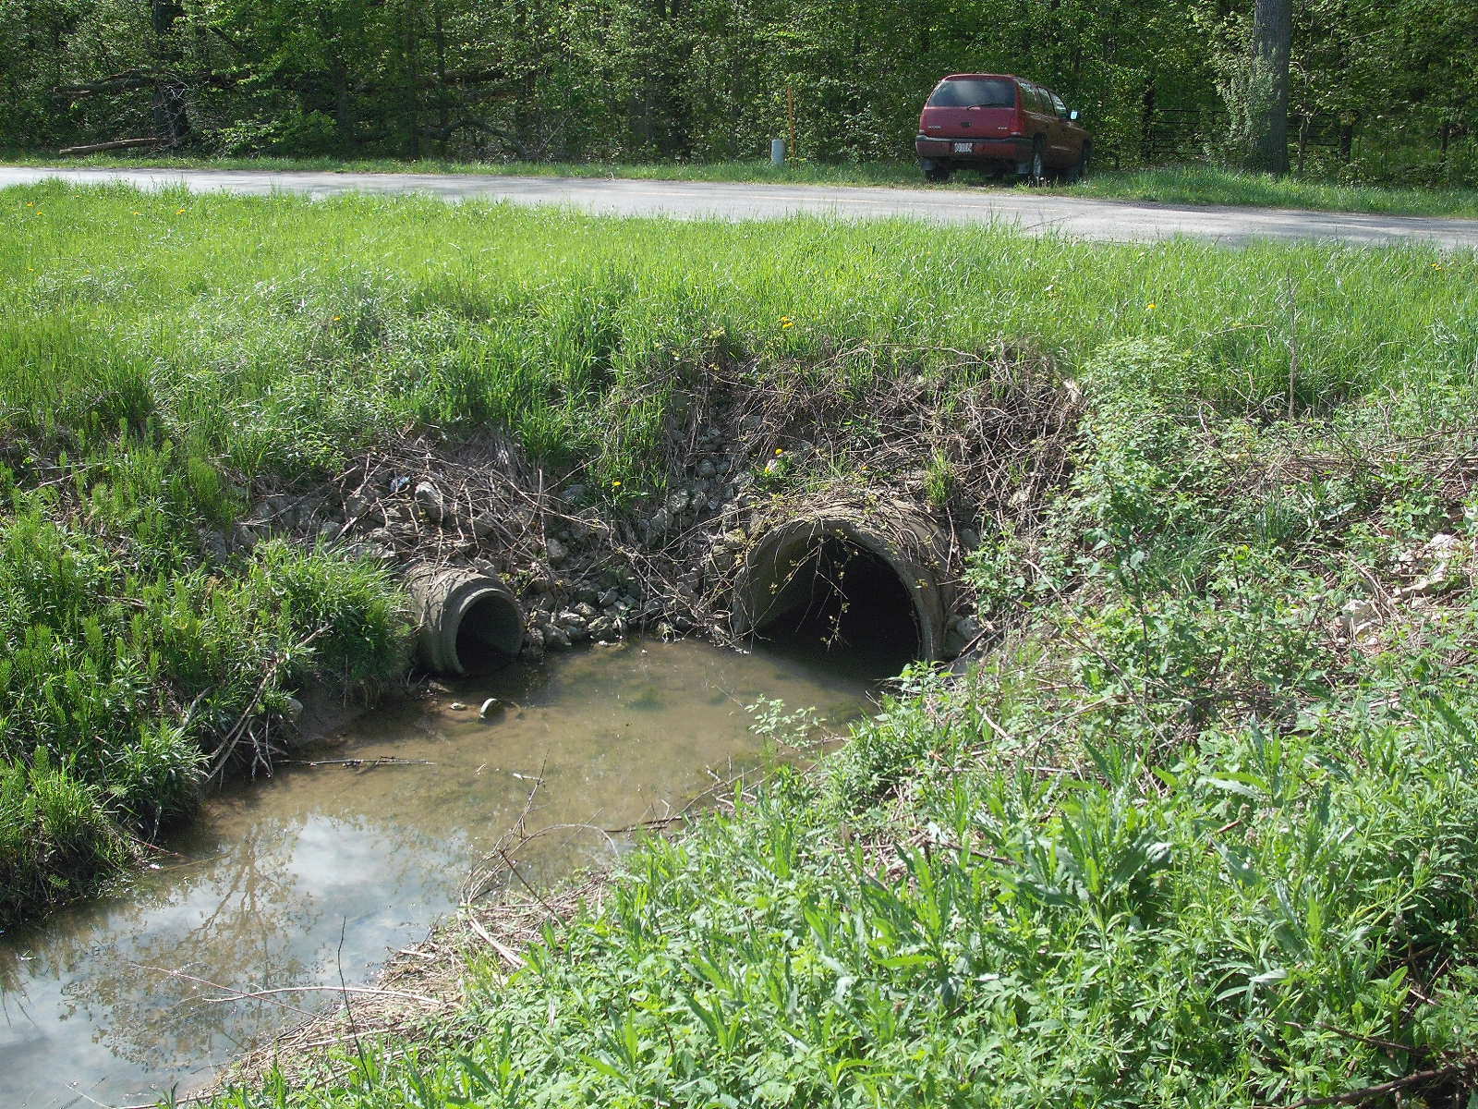

Slide 15
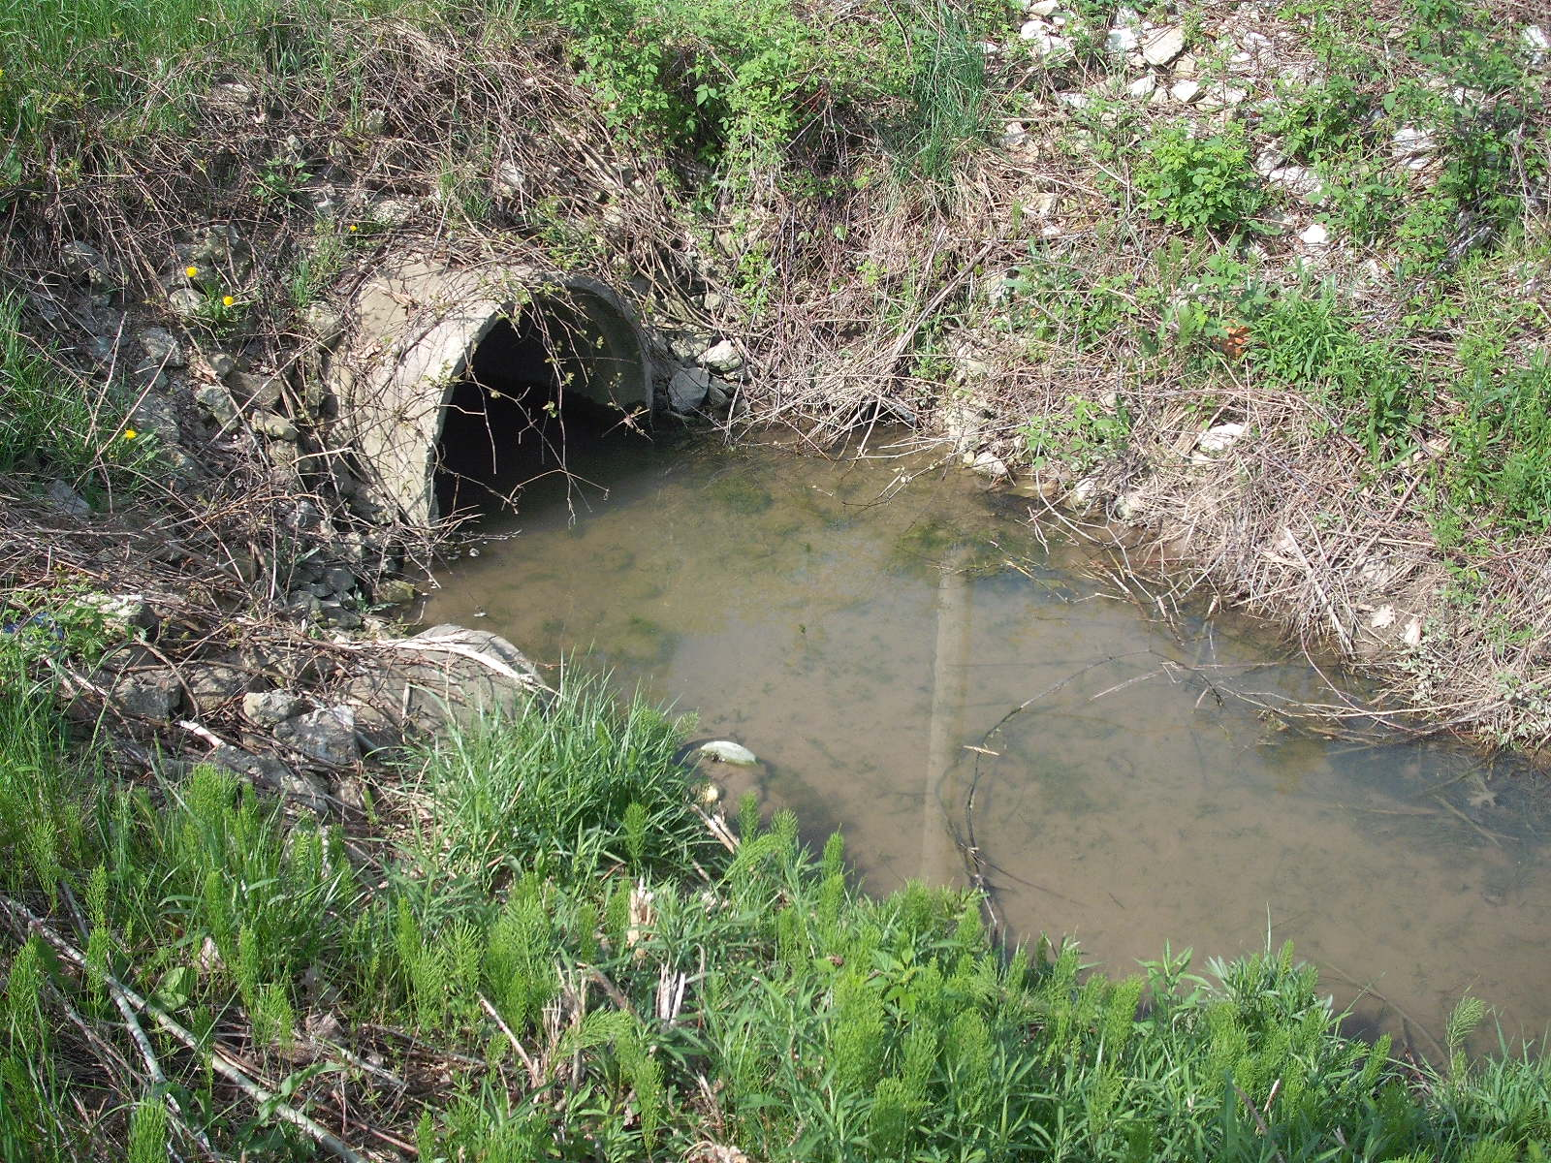

Slide 16
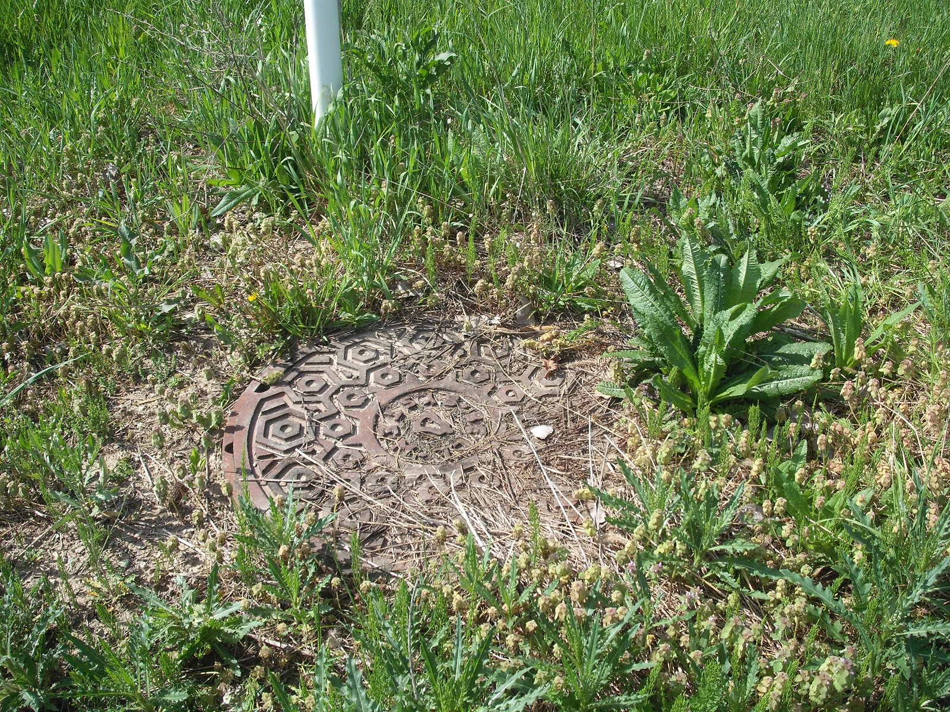

Slide 17
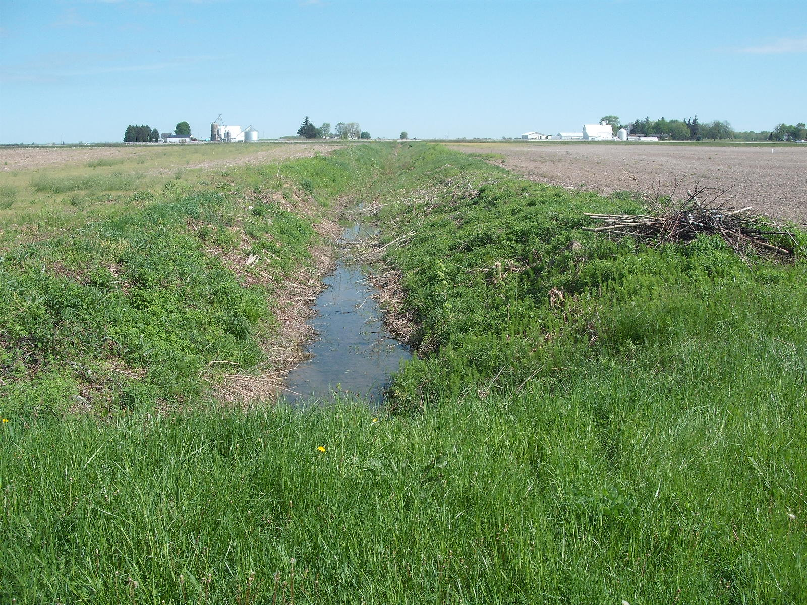

Slide 18
Branch 9 Brush Creek County Road H through woods
Section 12, T-7-N, R-5-E, German Township

Slide 20
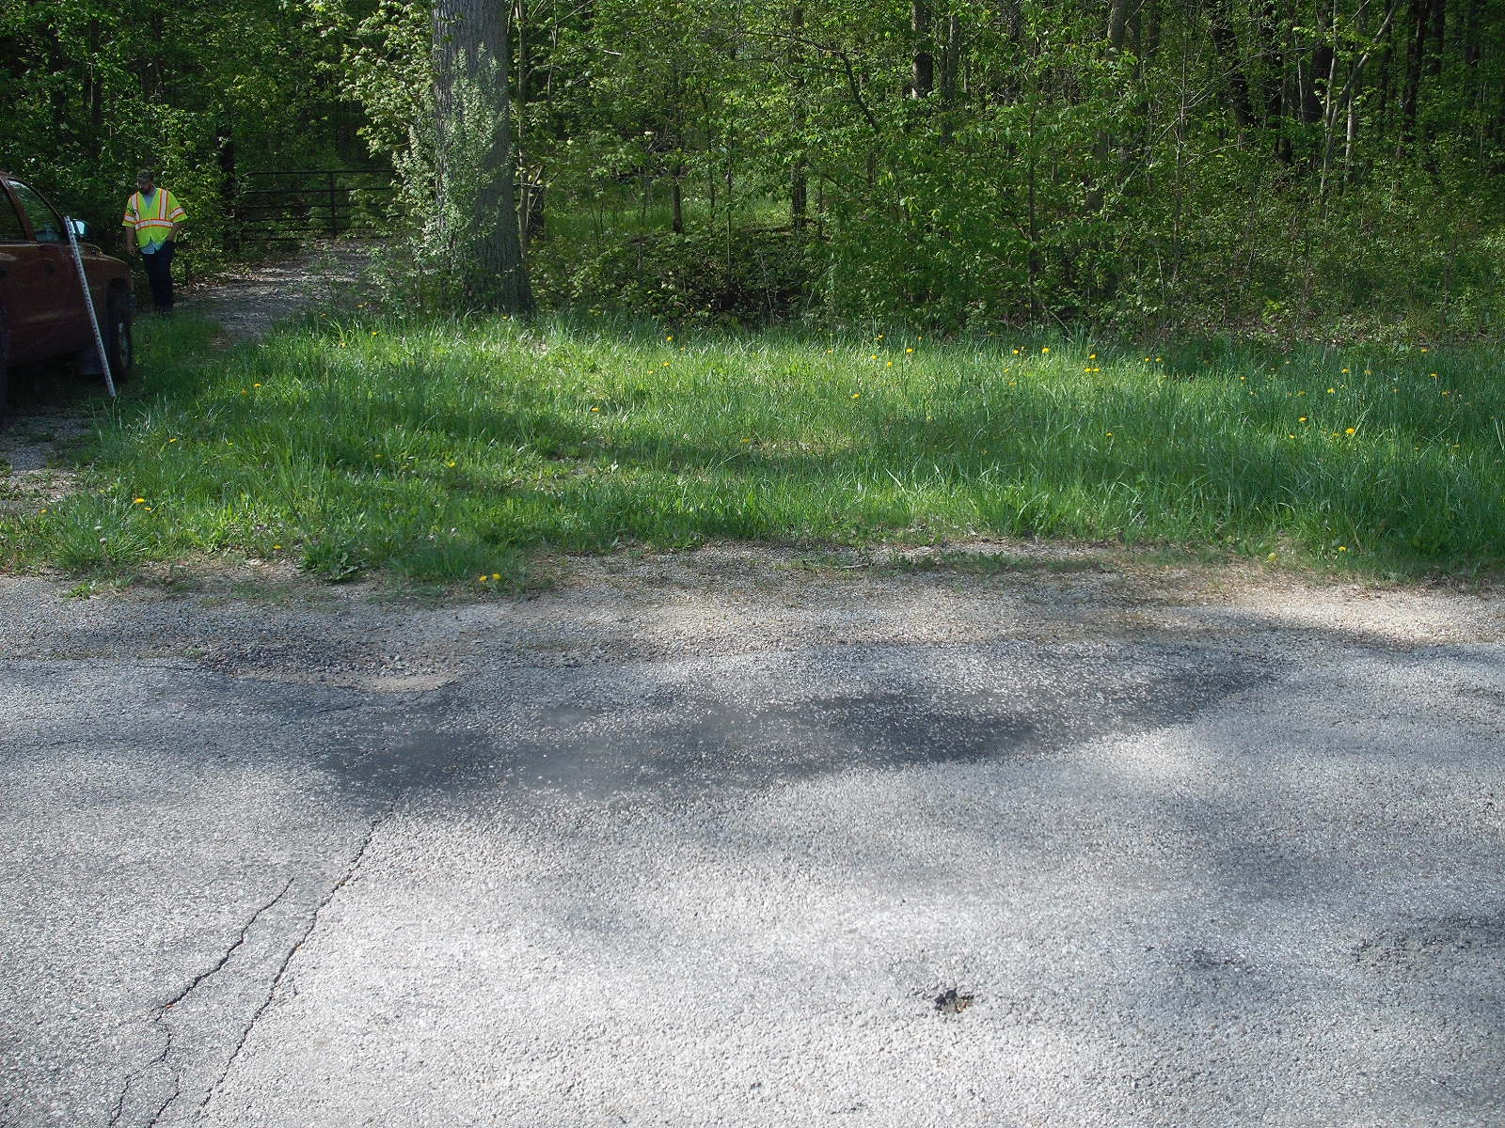

Slide 21
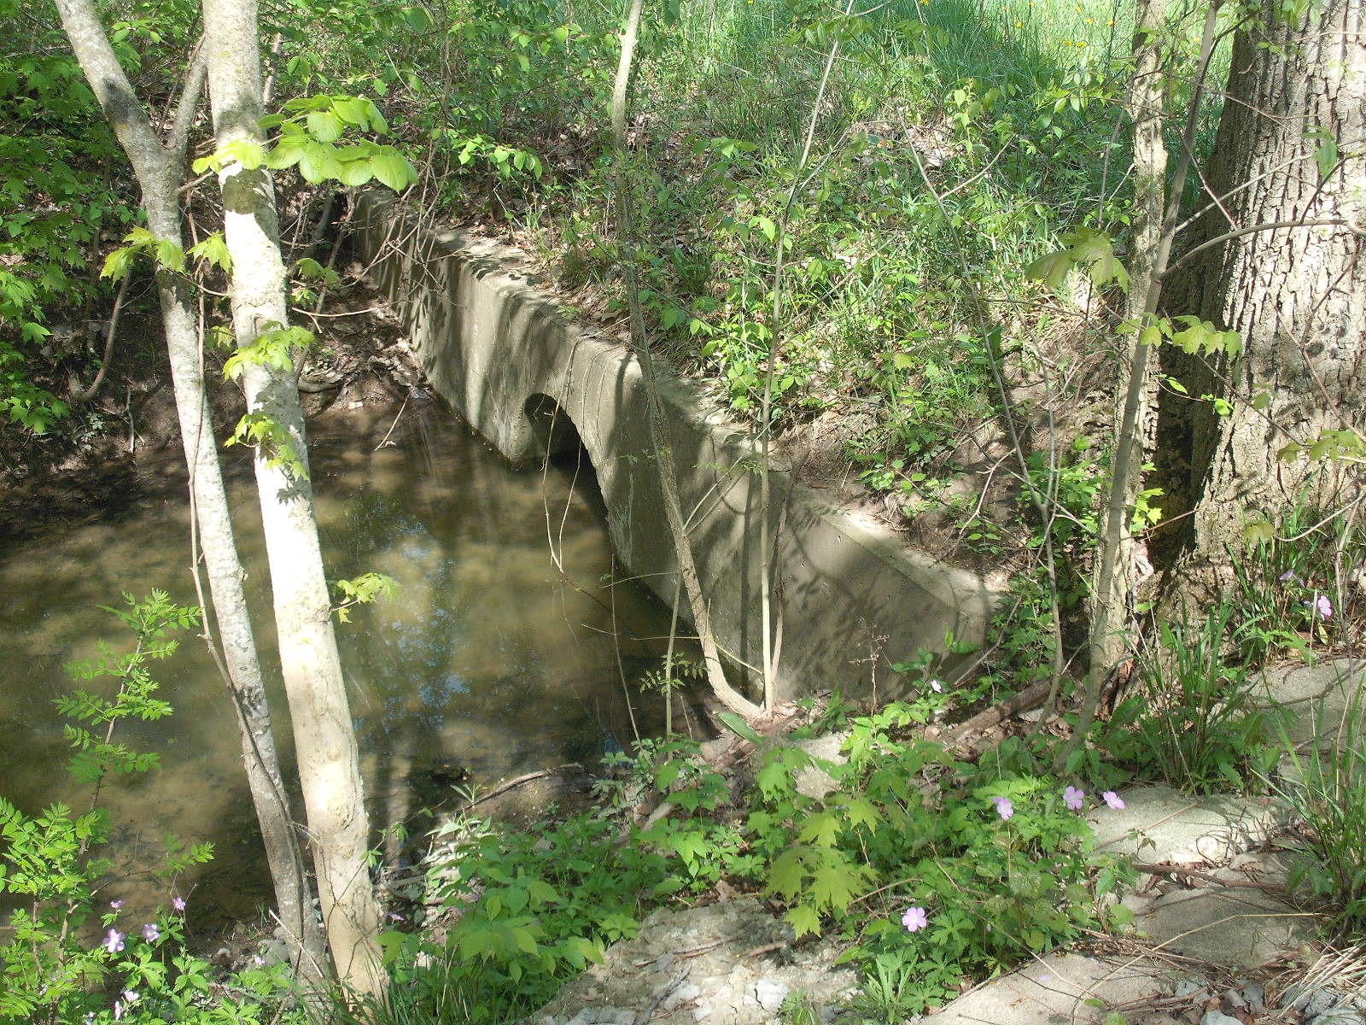

Slide 22
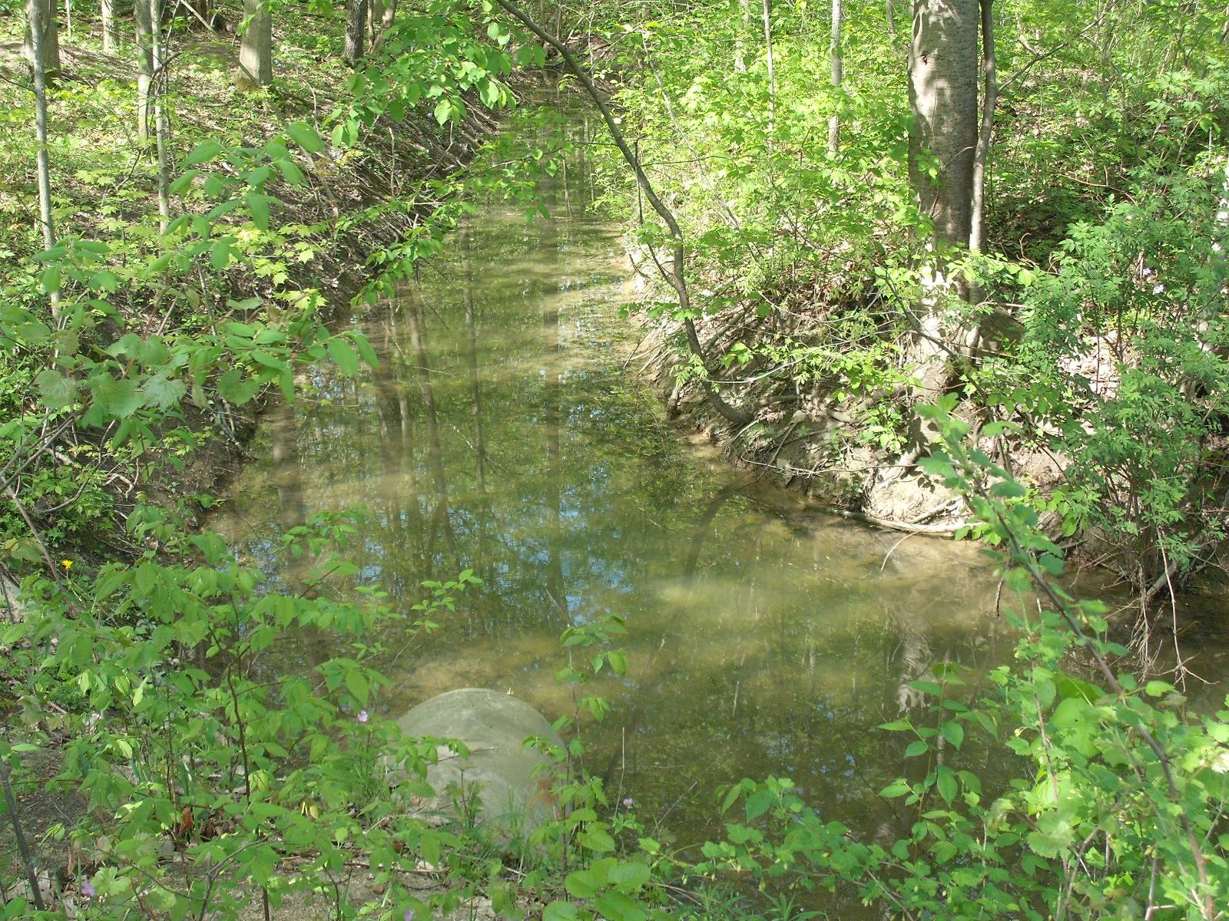

Slide 23
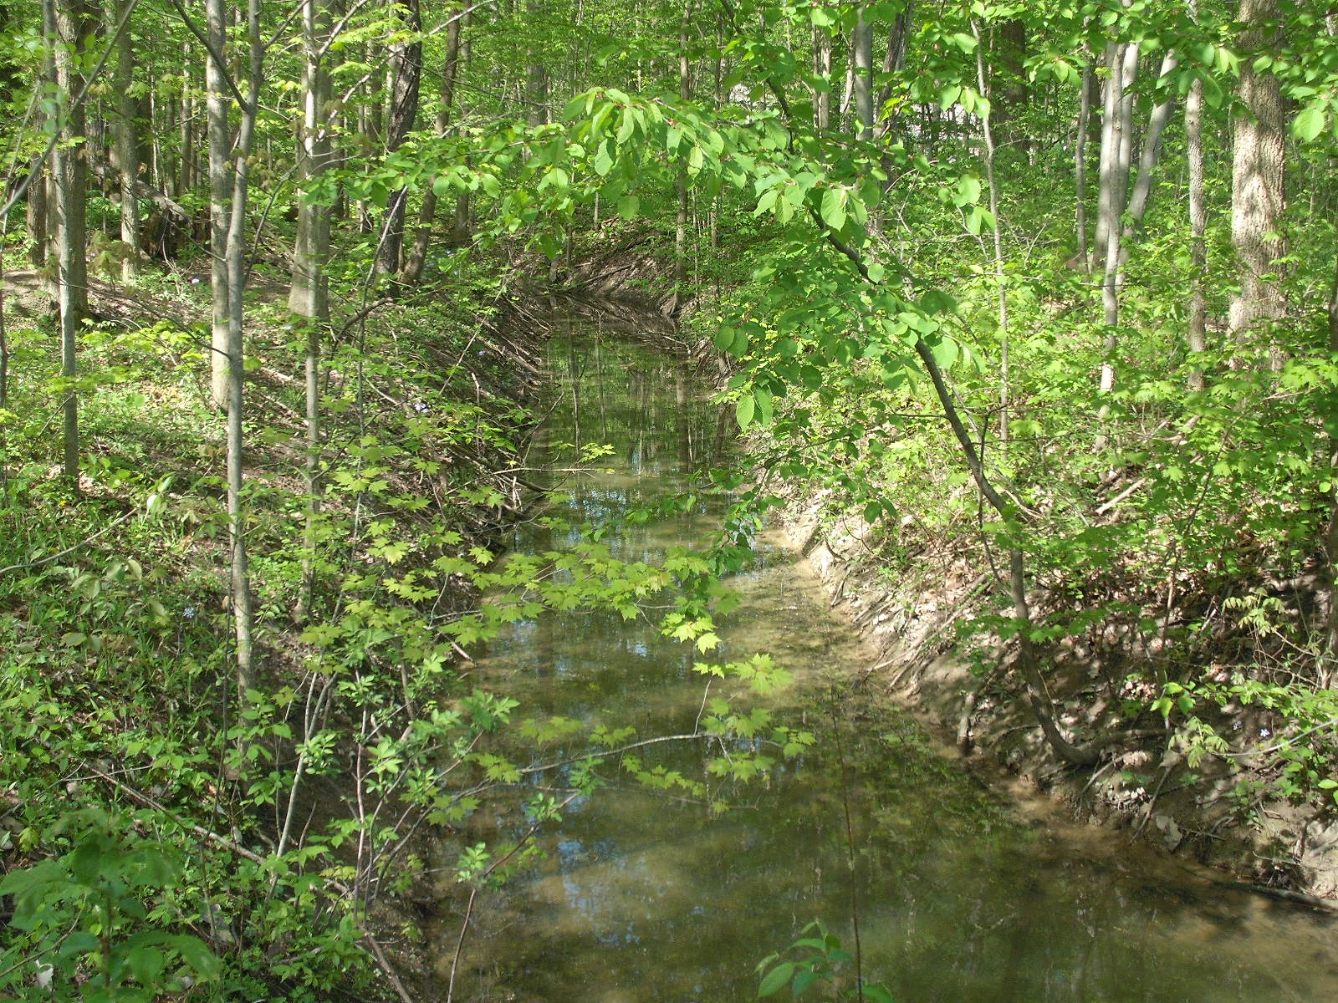

Slide 24
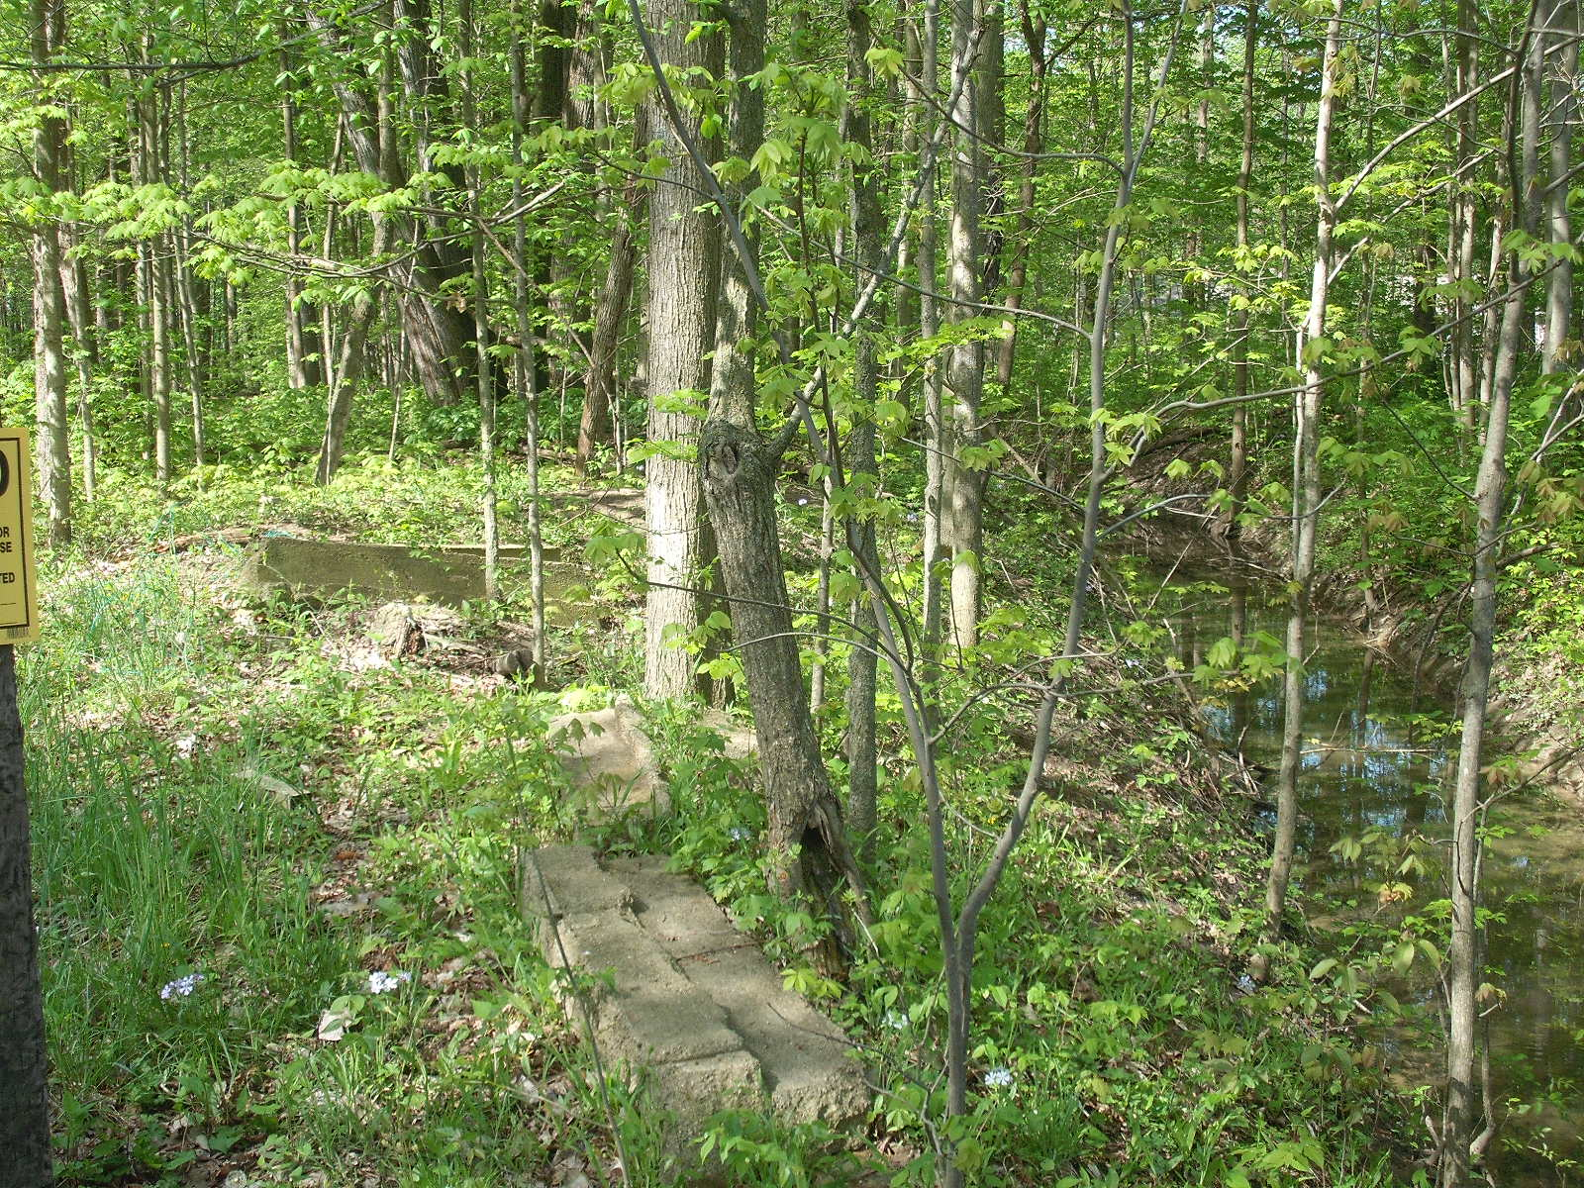

Slide 25
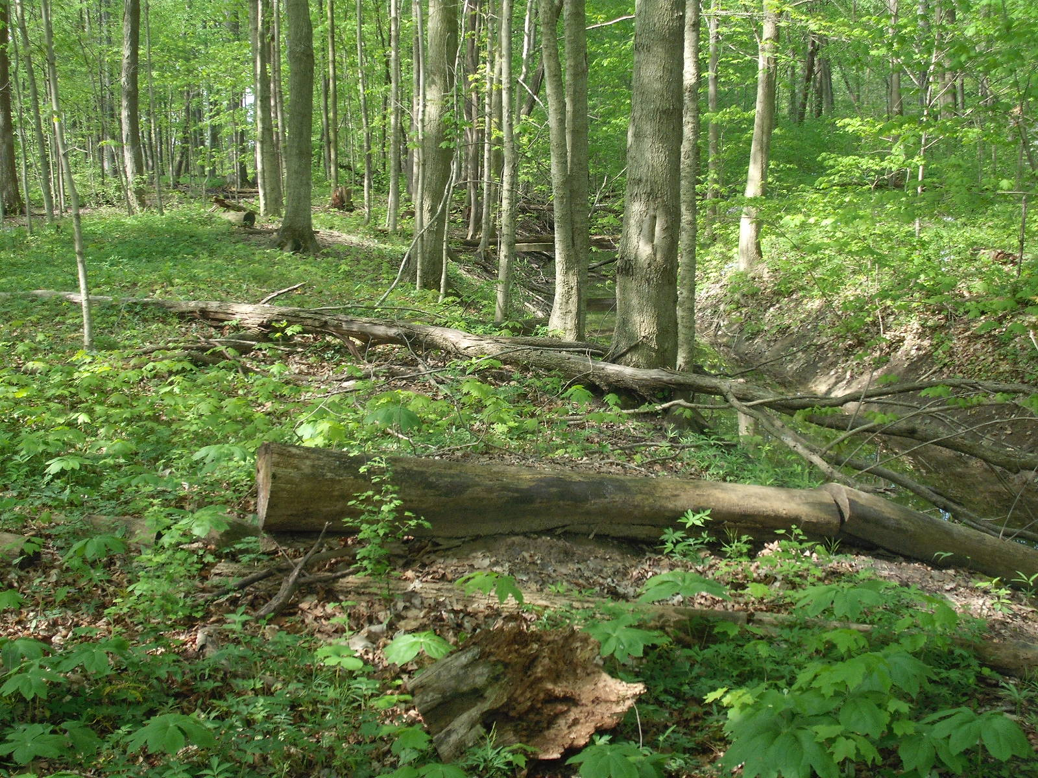

Slide 26
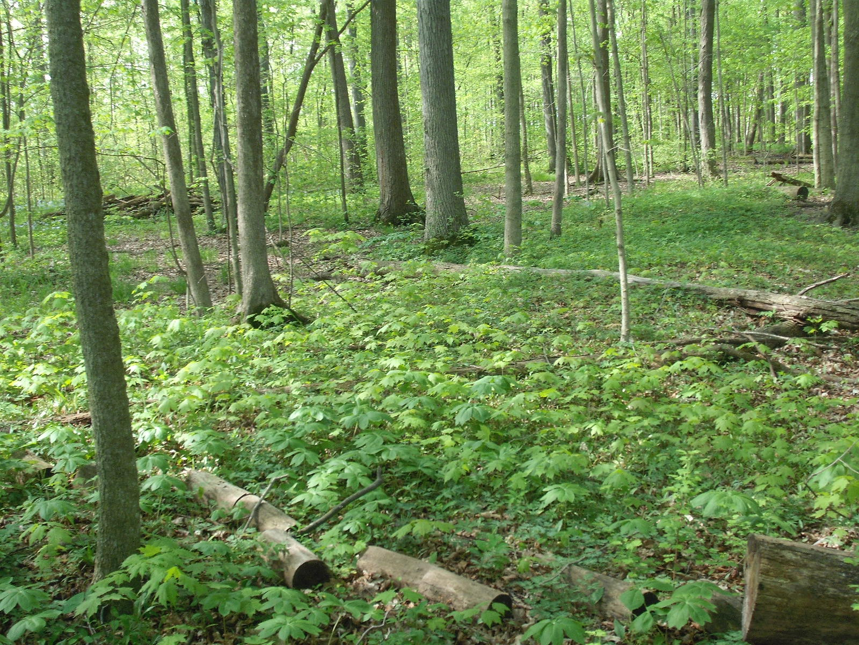

Slide 27
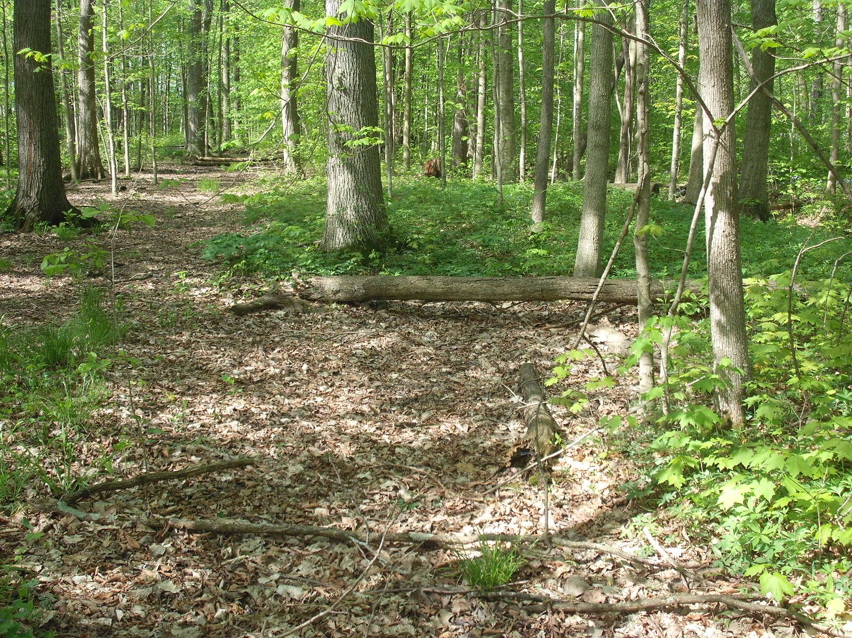

Slide 28
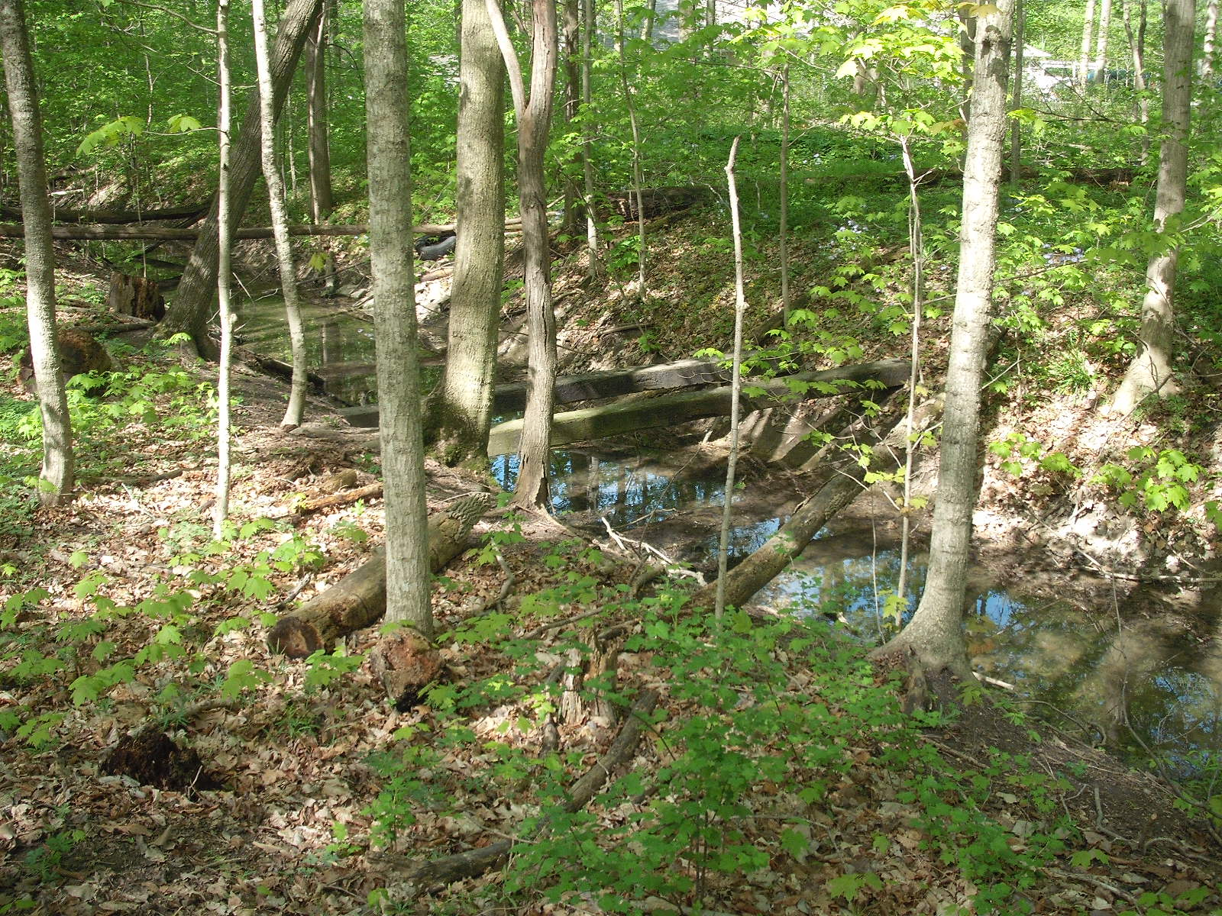

Slide 29
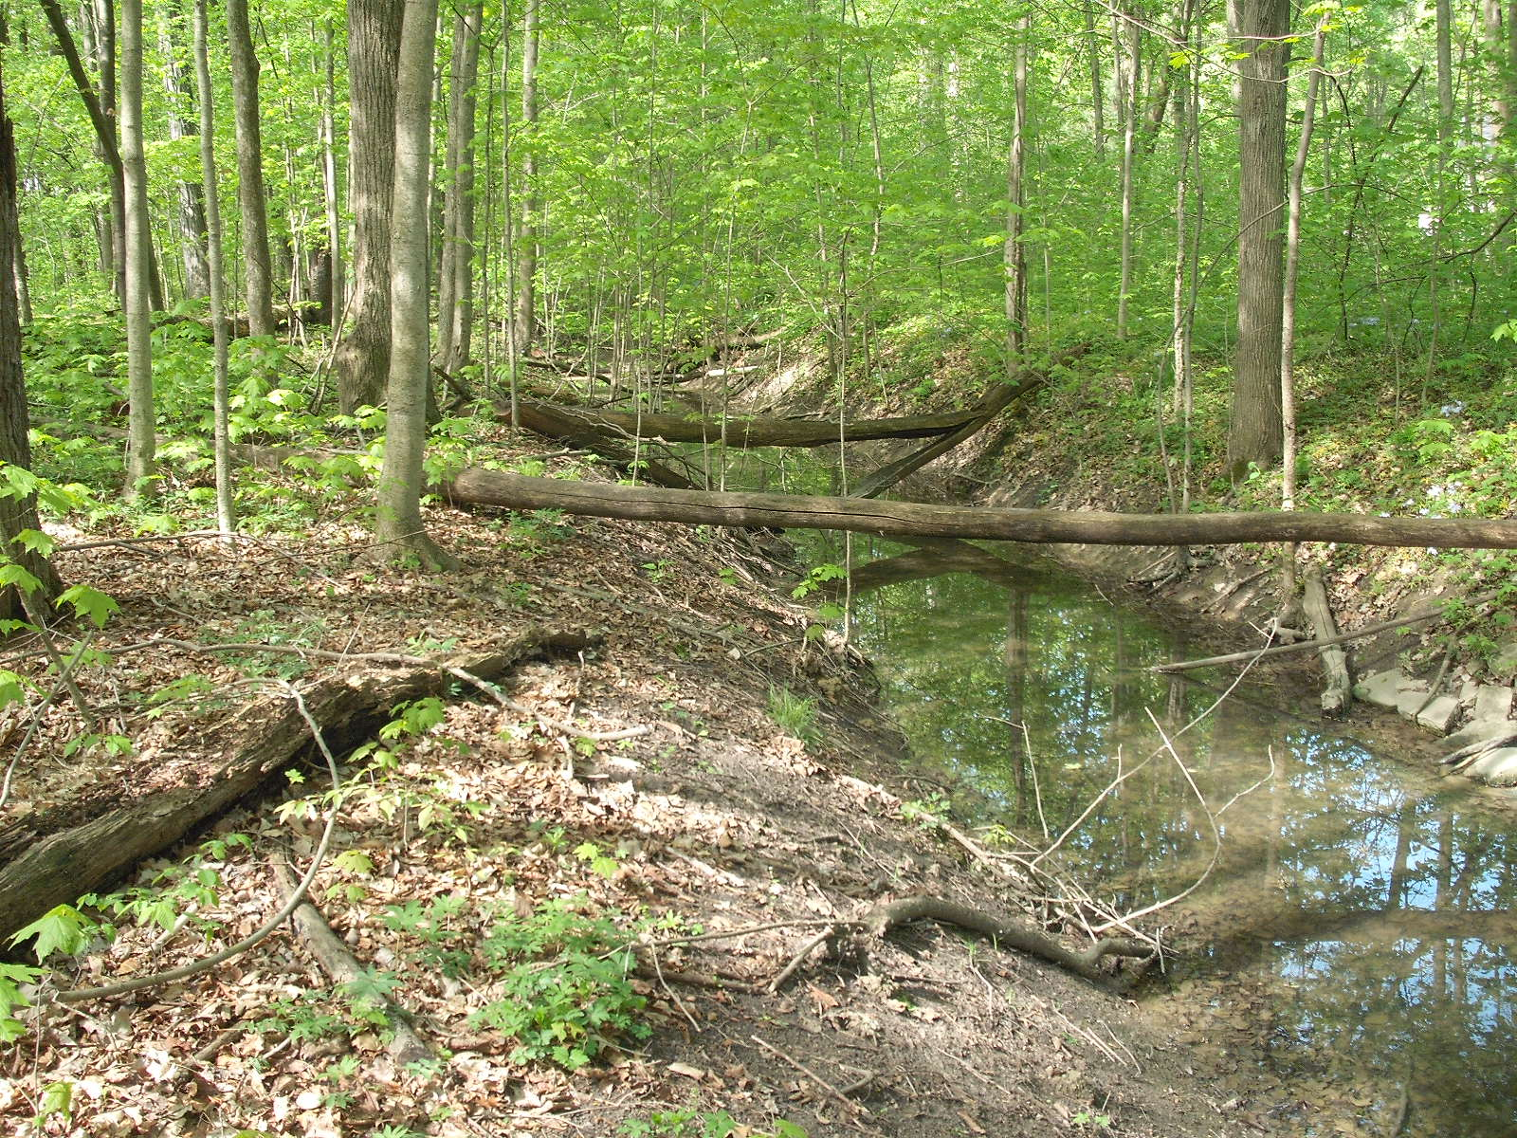

Slide 30
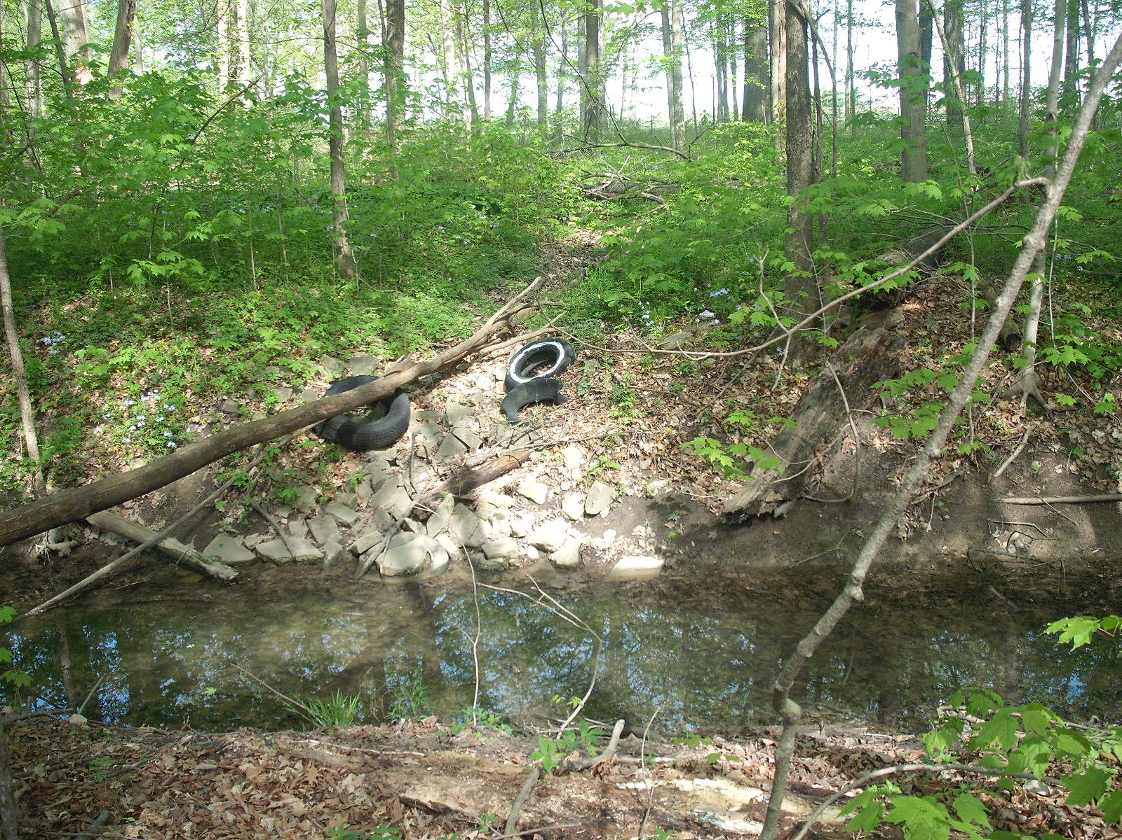

Slide 31
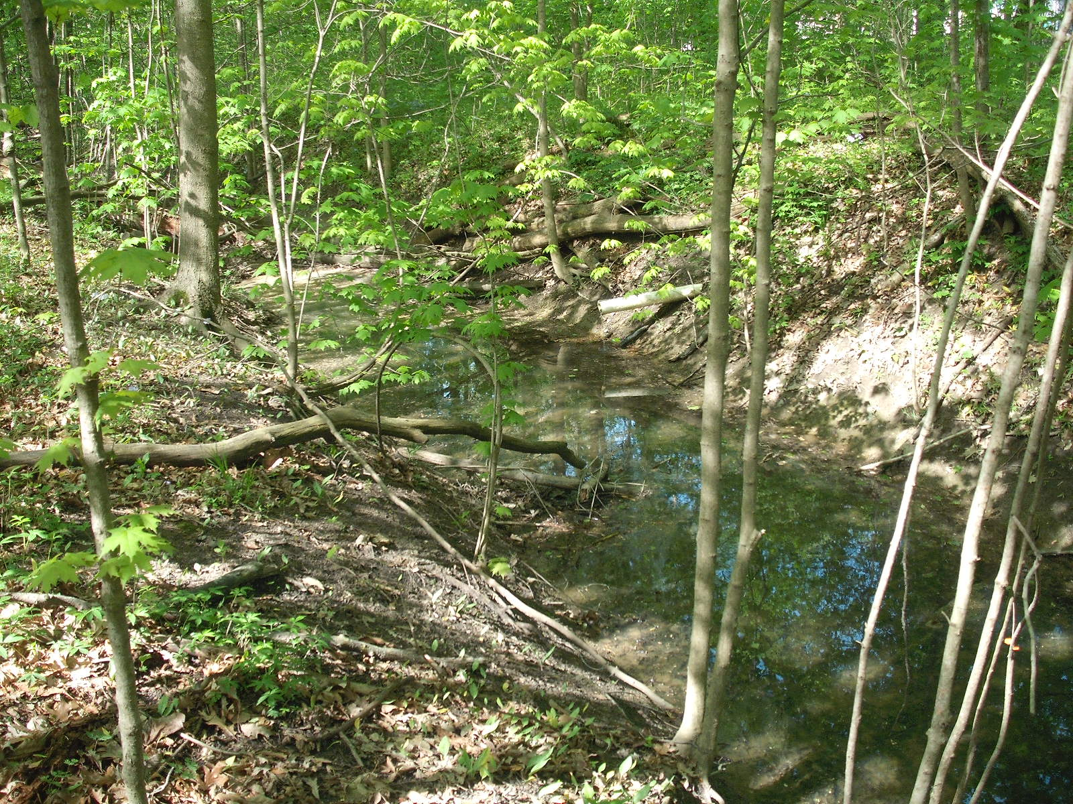

Slide 32
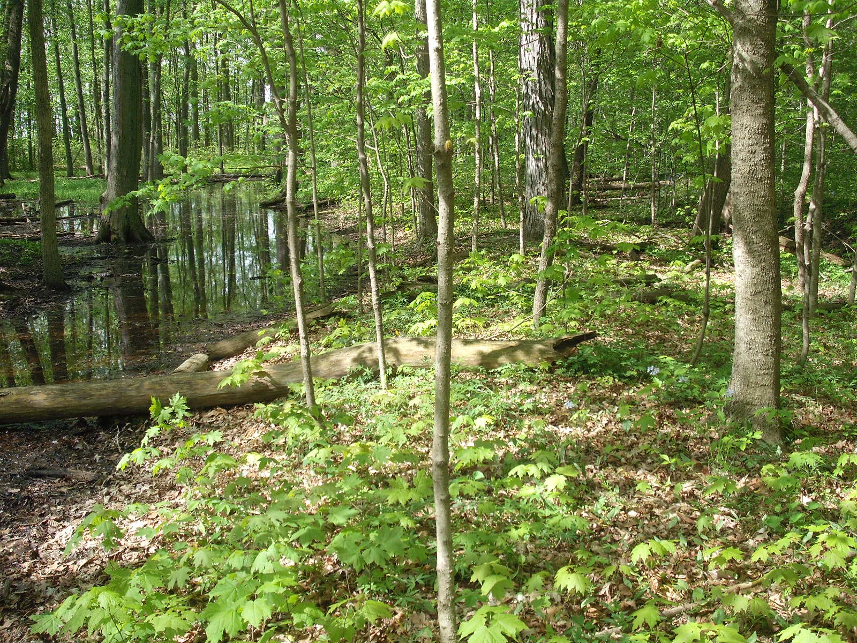

Slide 33
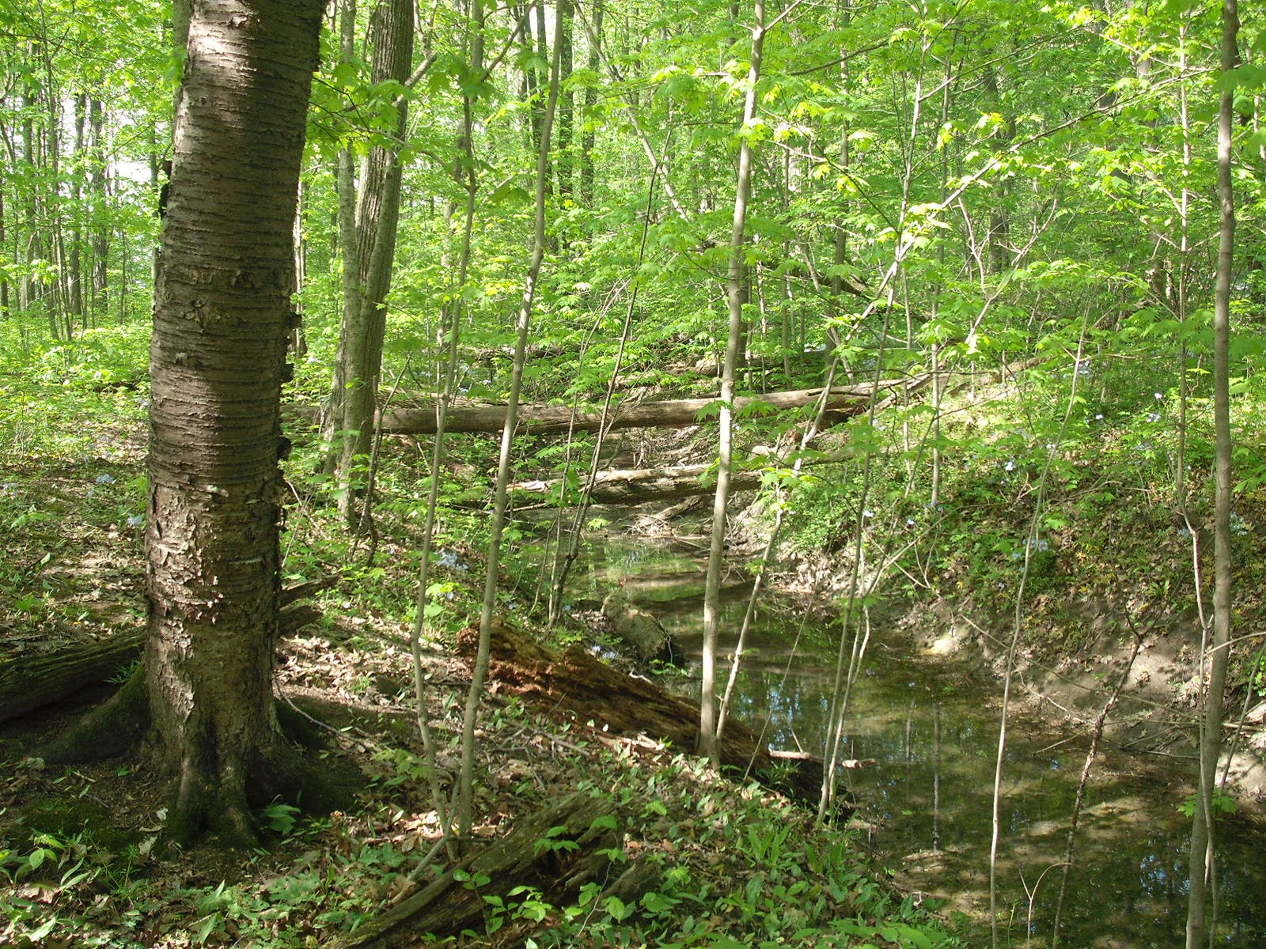

Slide 34
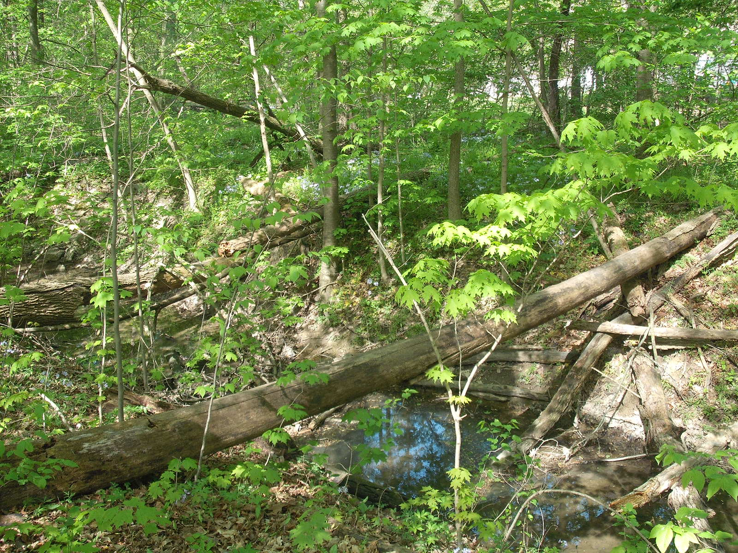

Slide 35
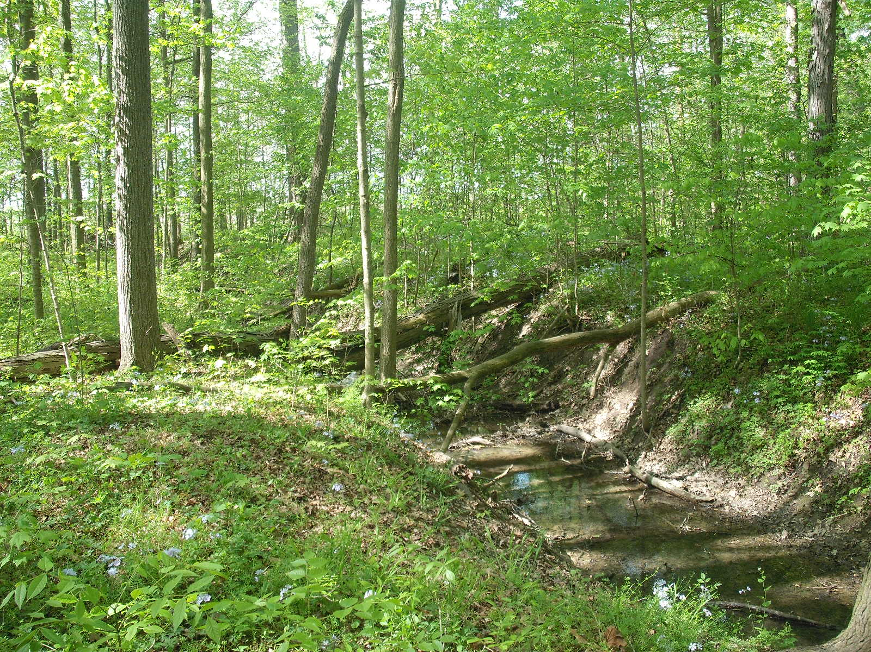

Slide 36
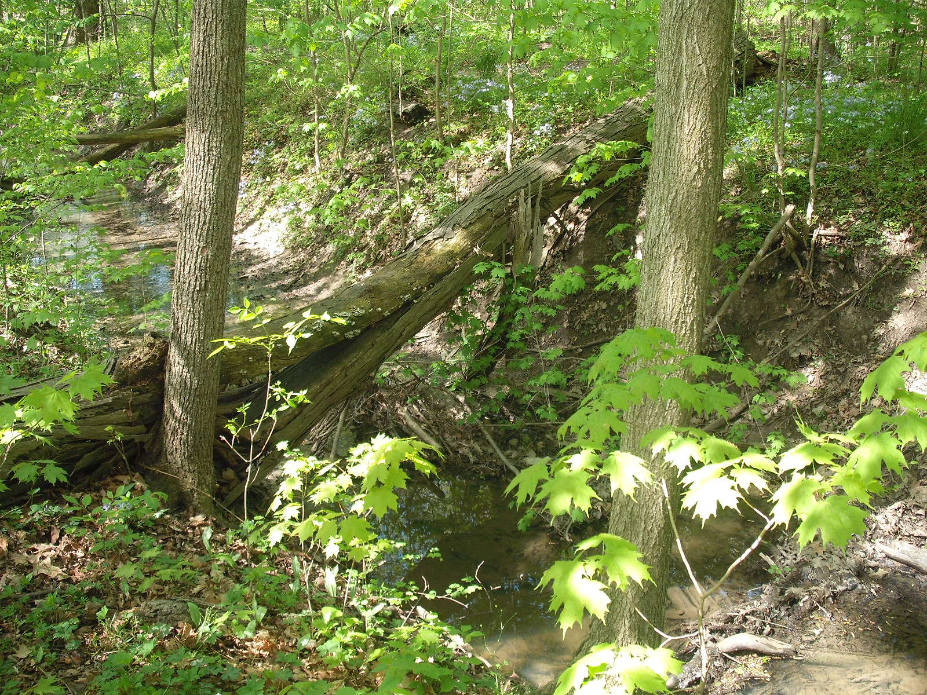

Slide 37
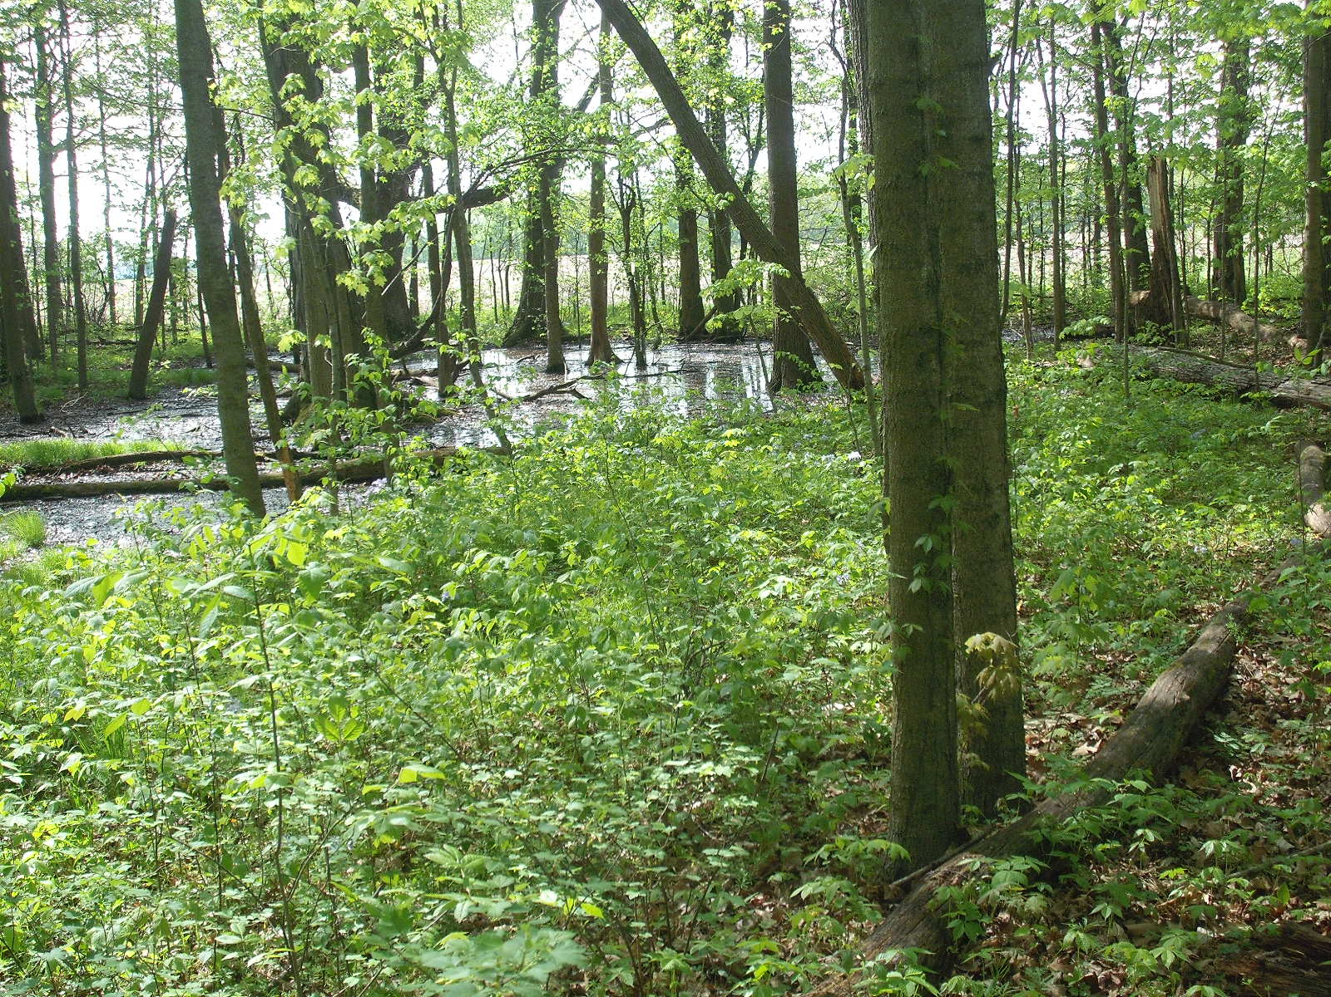

Slide 38
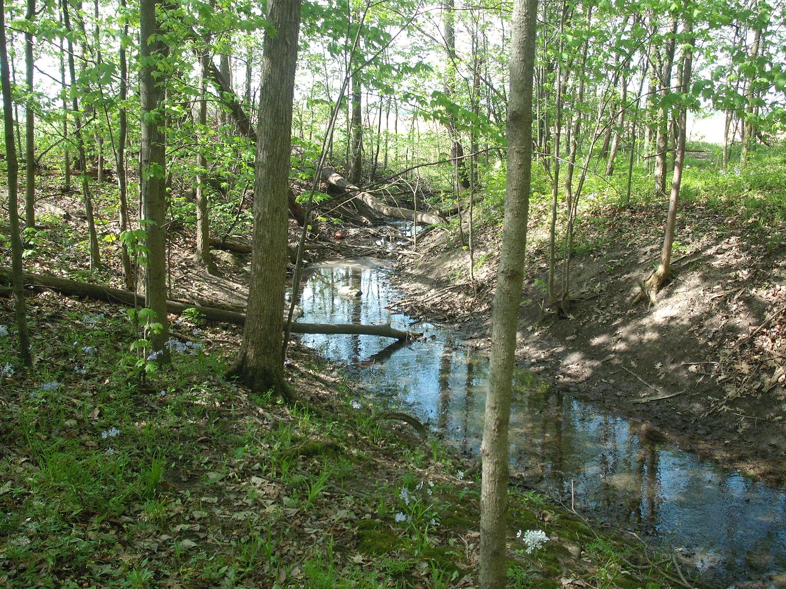

Slide 39
Branch 9 Brush Creek South side woods to Center Section
Section 12, T-7-N, R-5-E, German Township

Slide 41
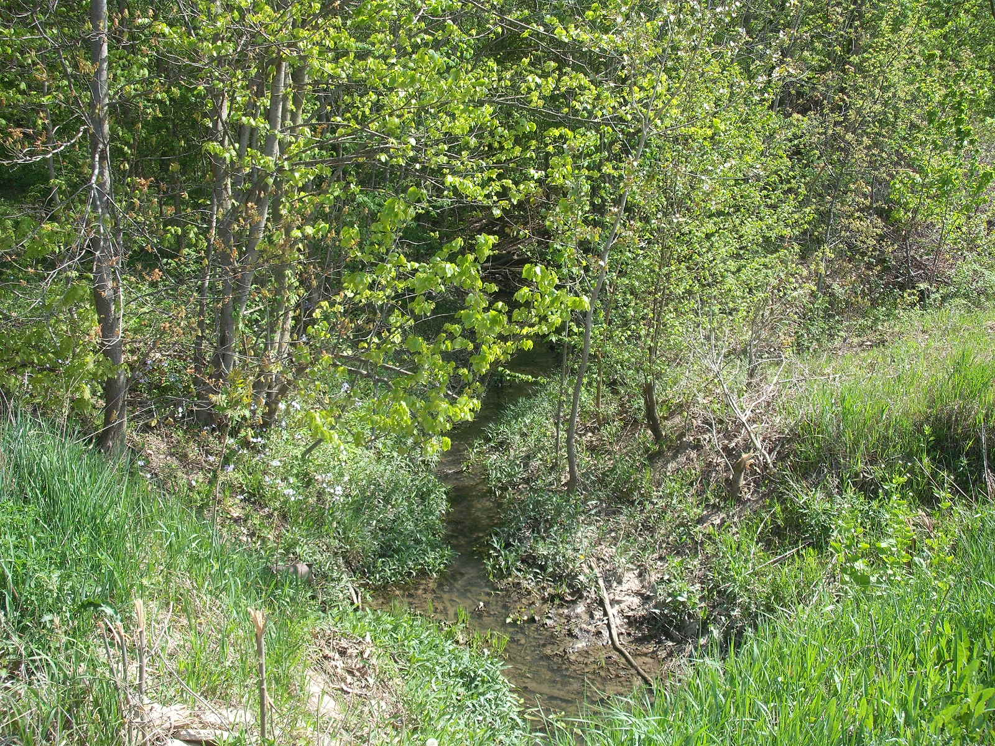

Slide 42
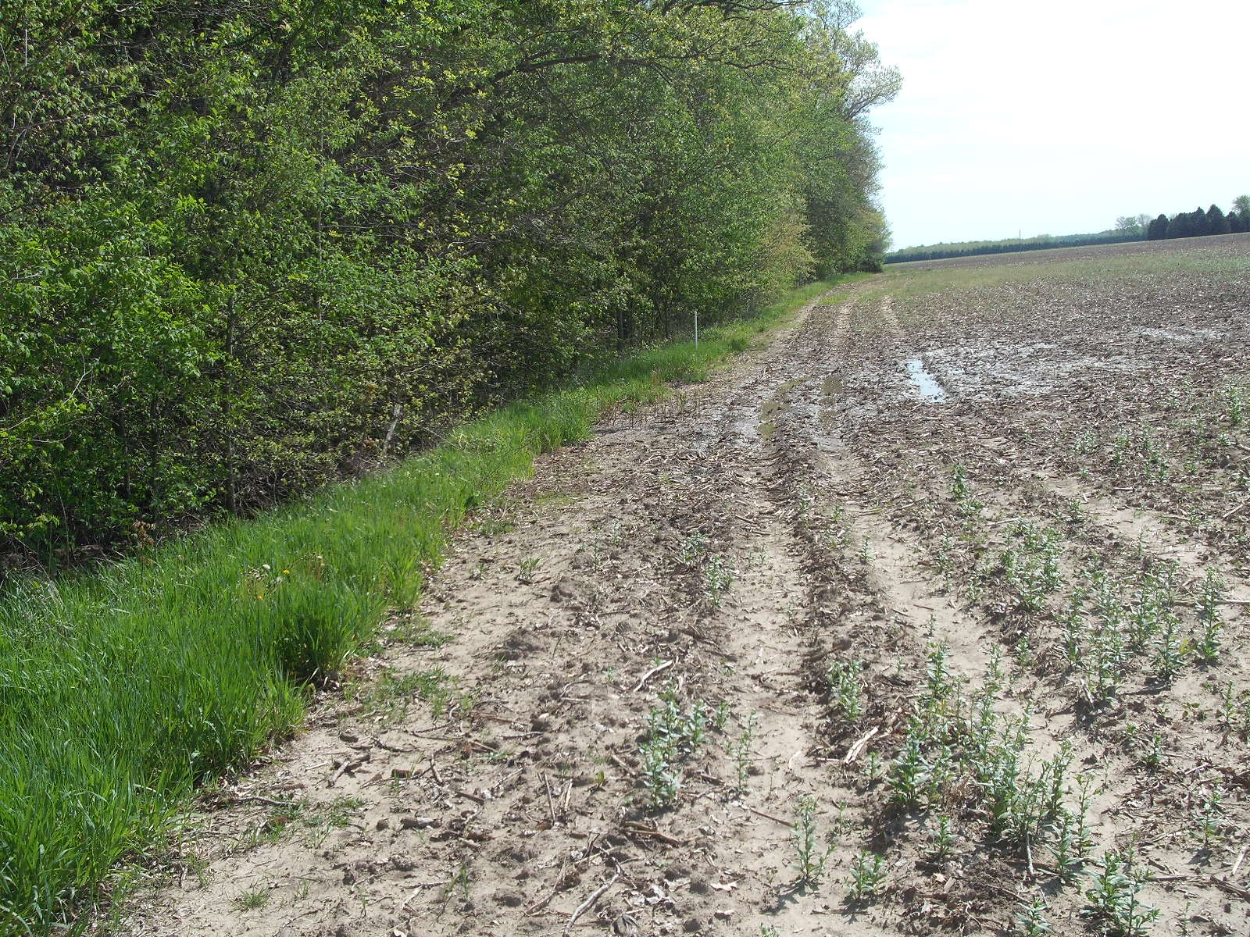

Slide 43
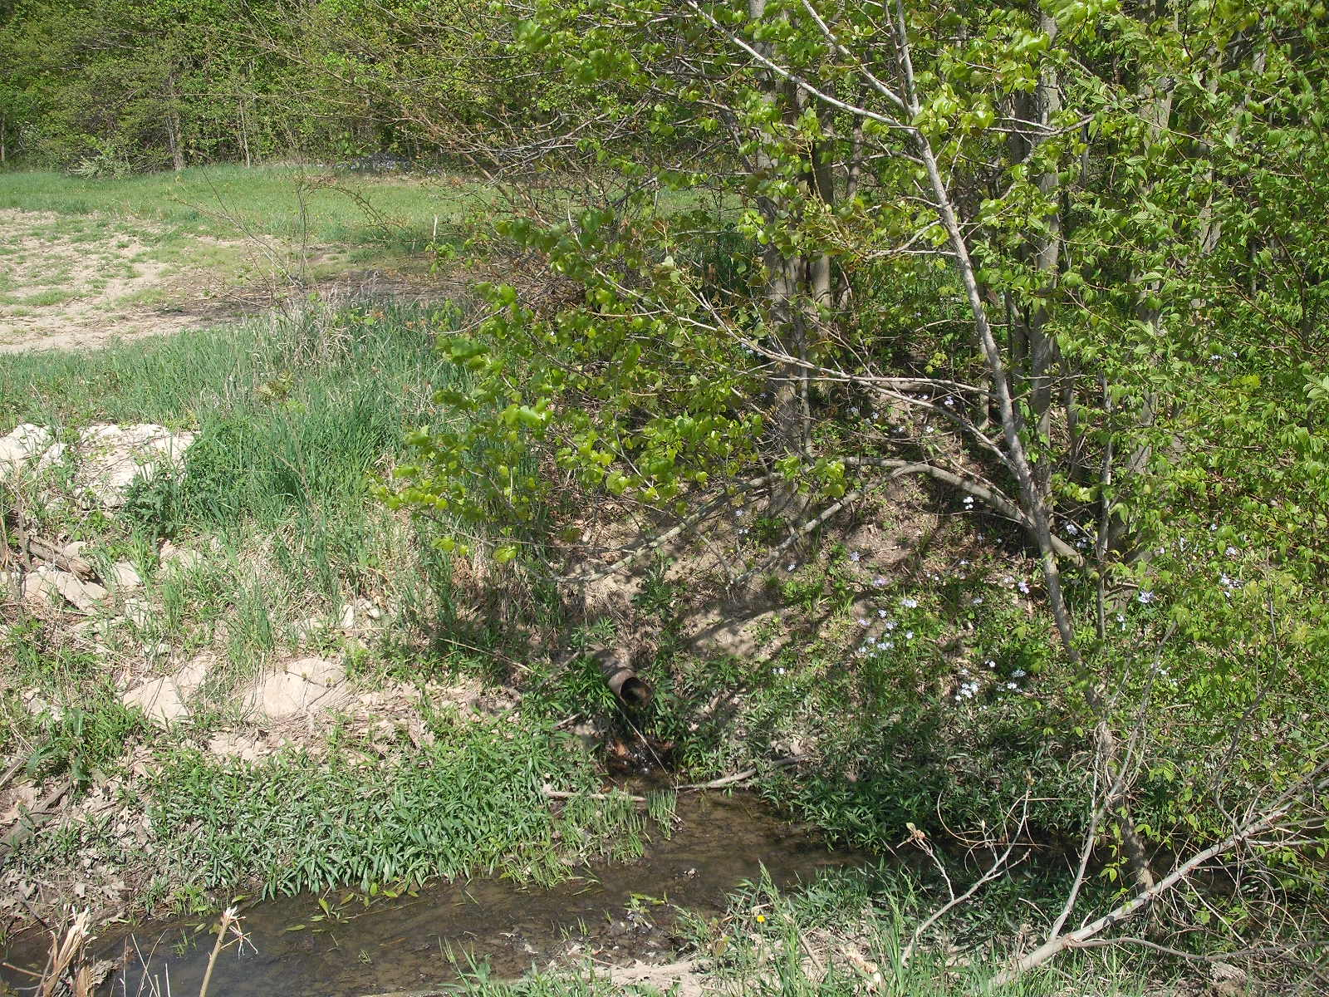

Slide 44
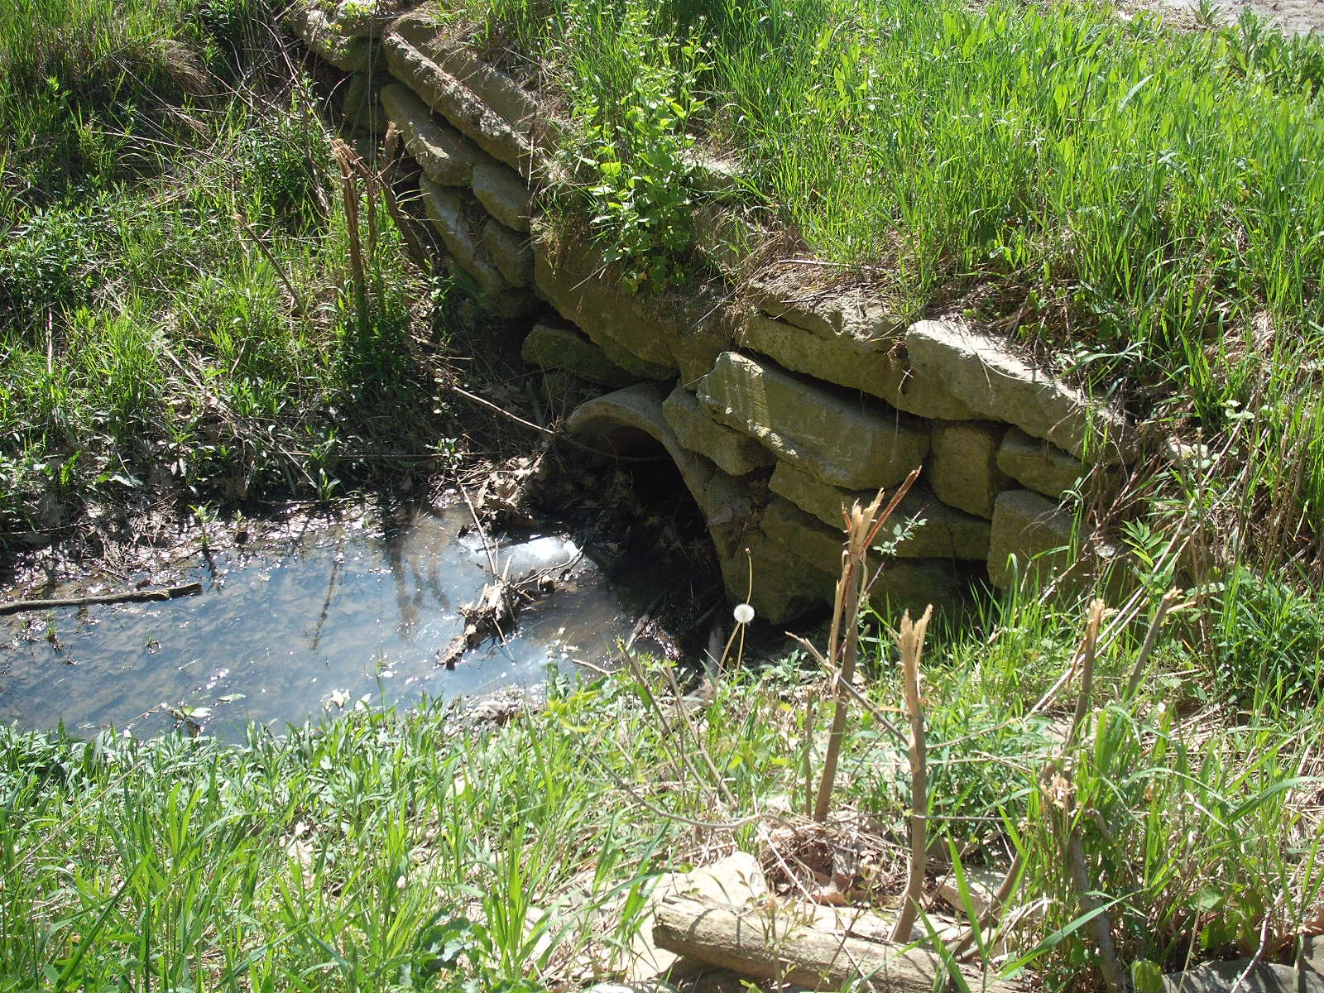

Slide 45
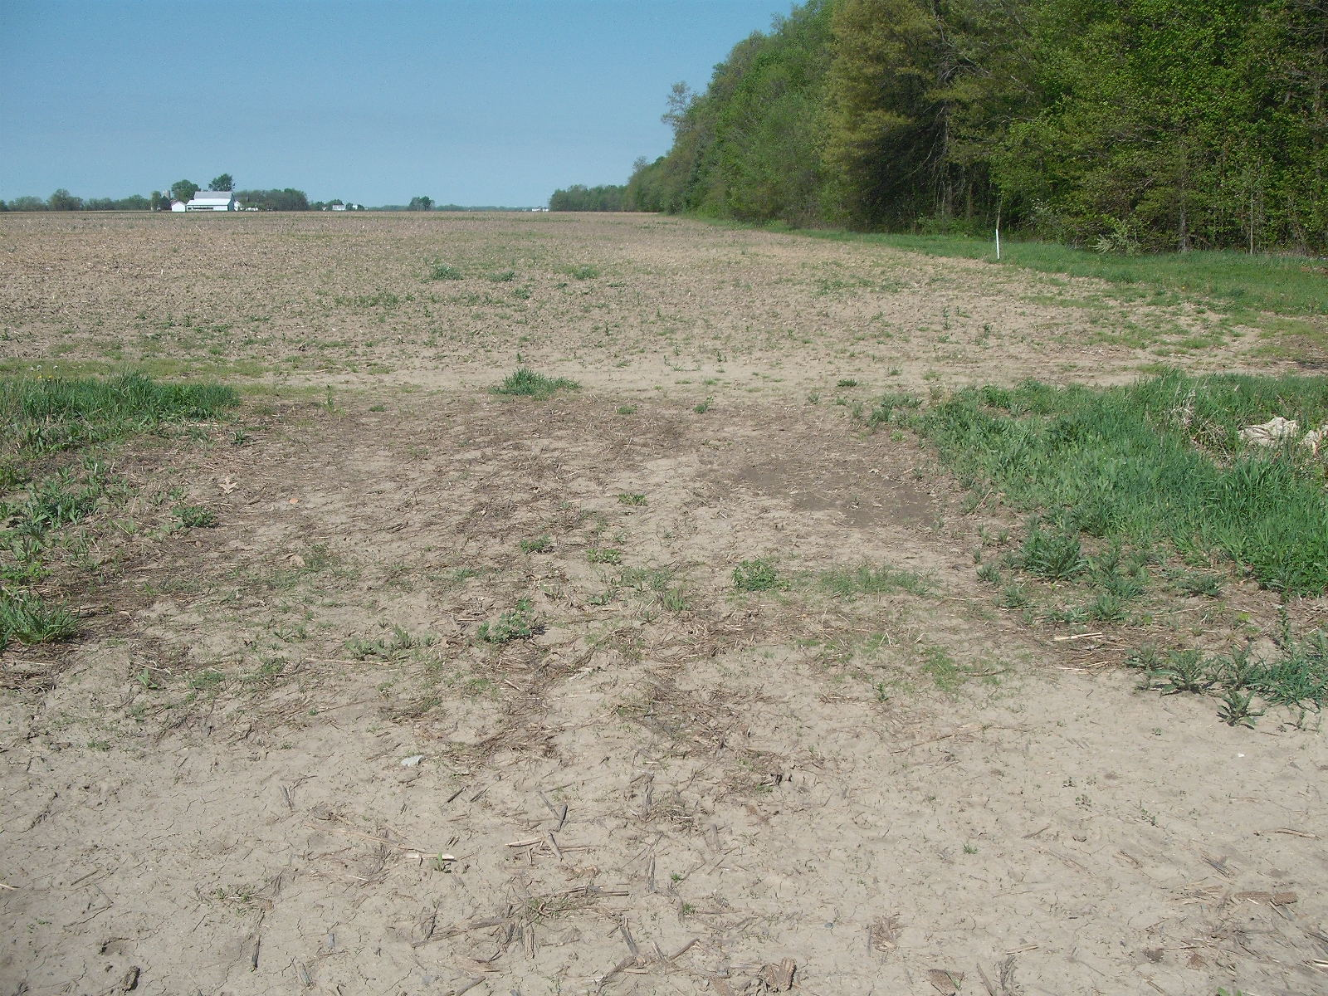

Slide 46
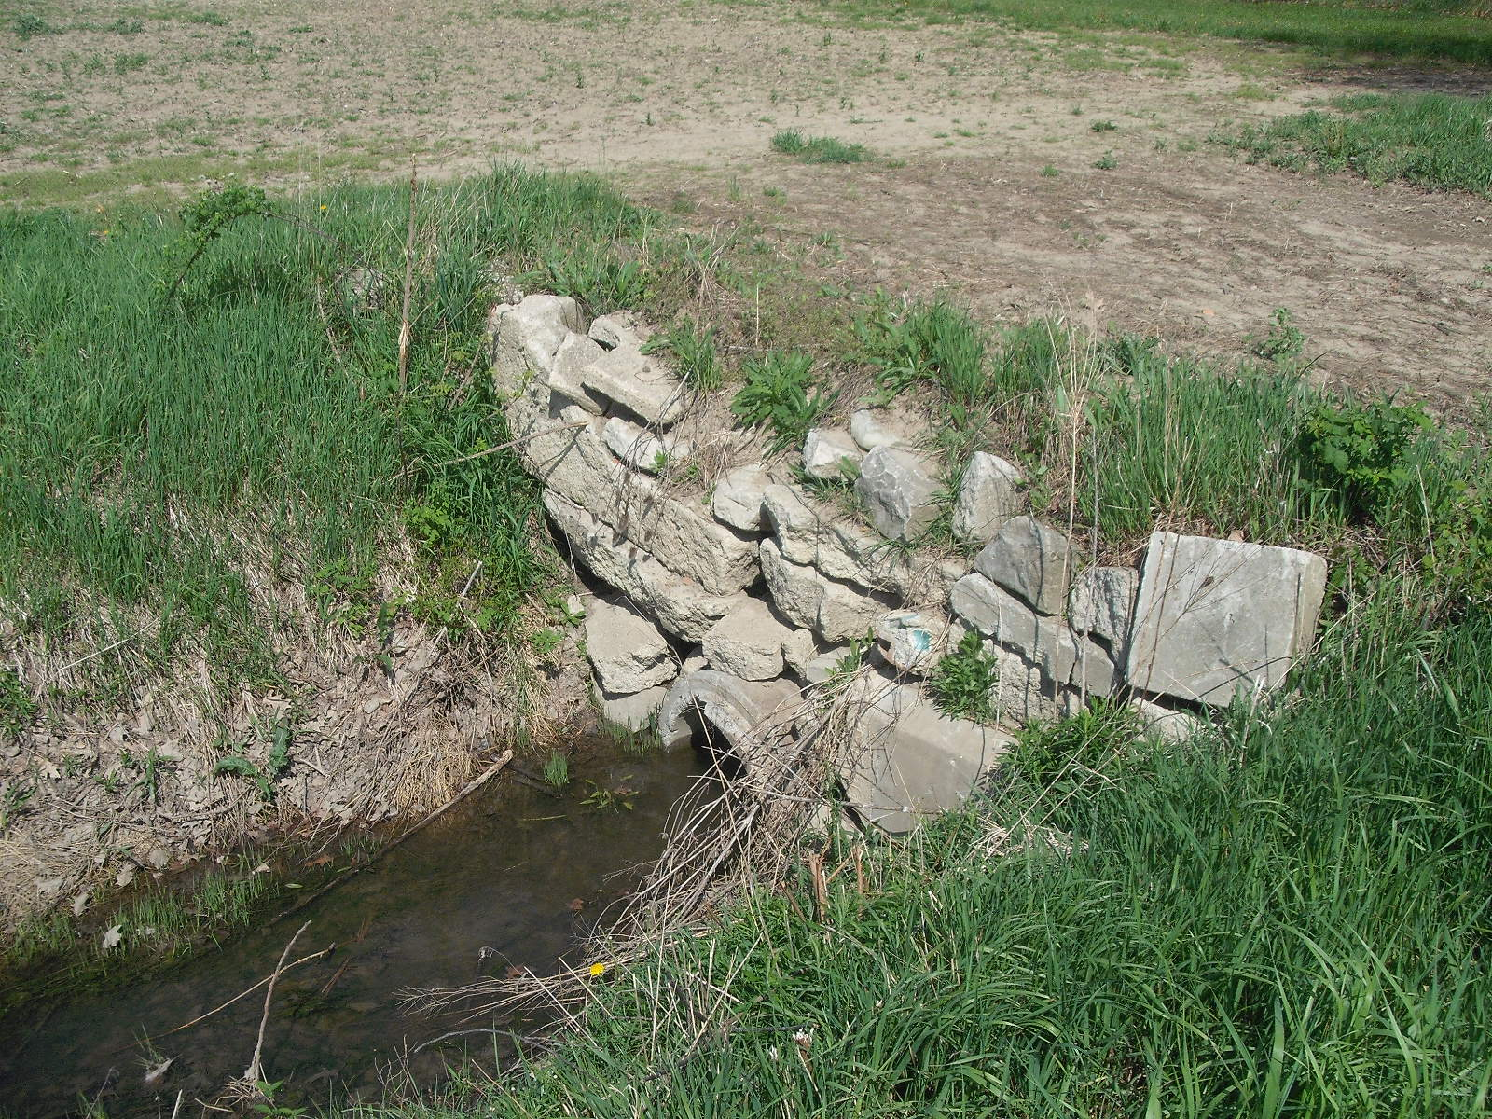

Slide 47
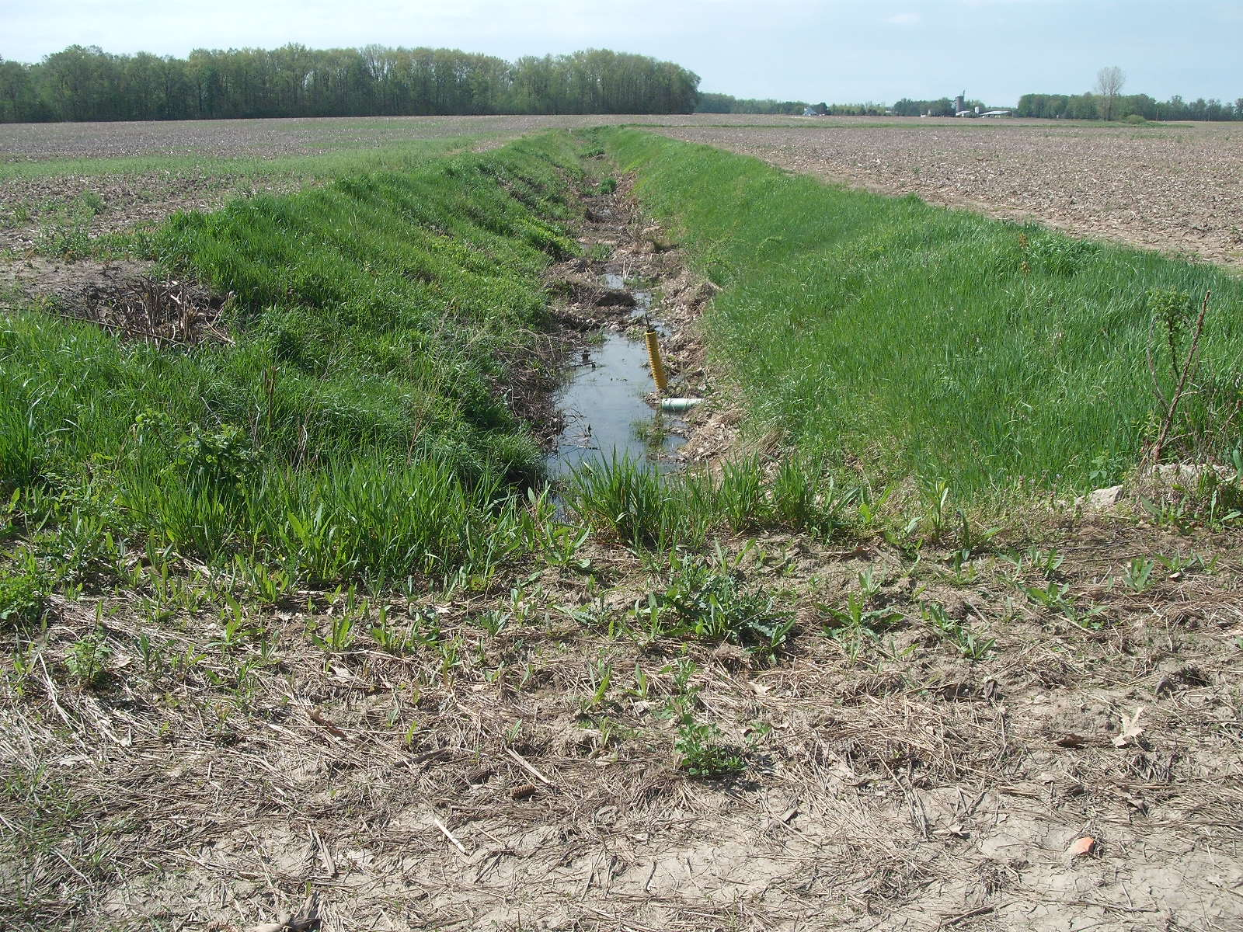

Slide 48
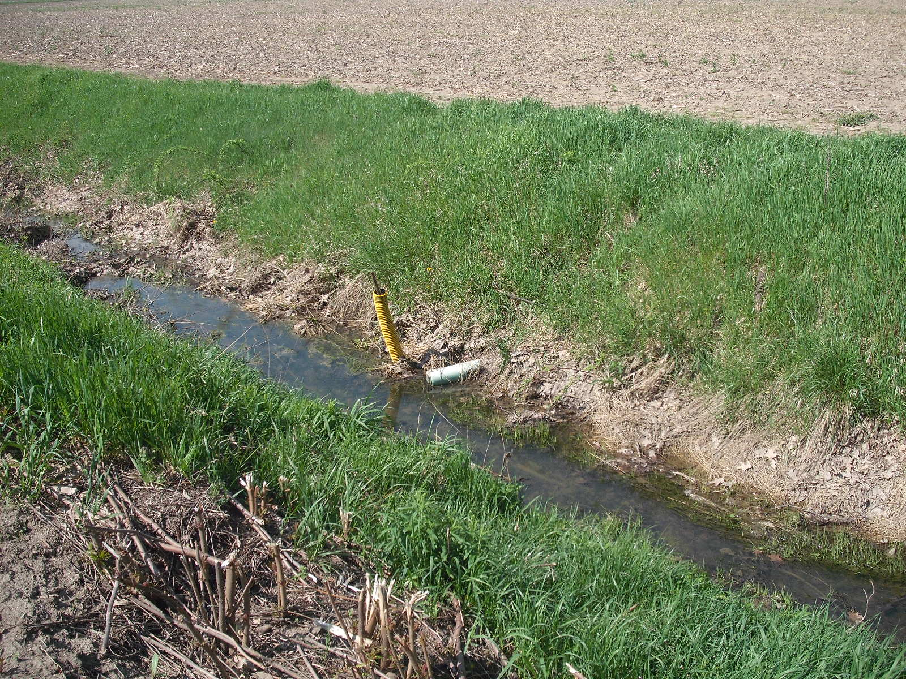

Slide 49
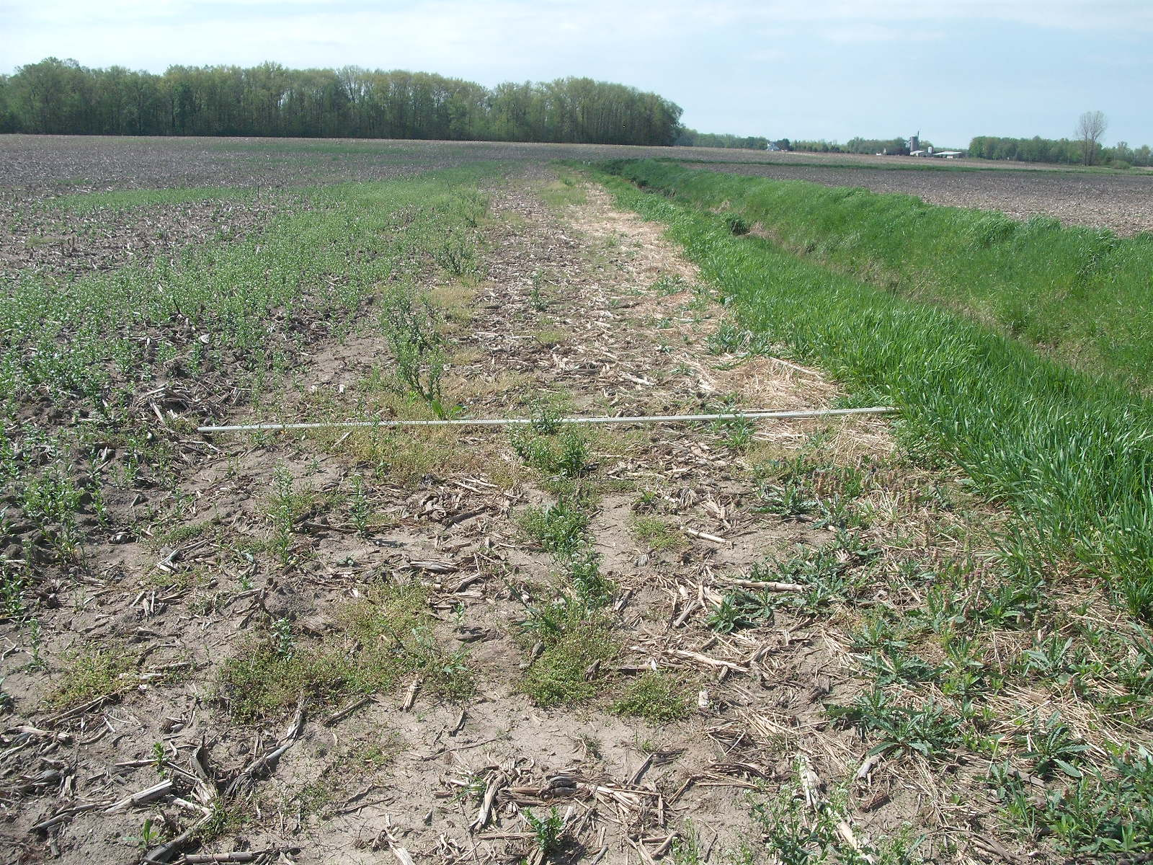

Slide 50
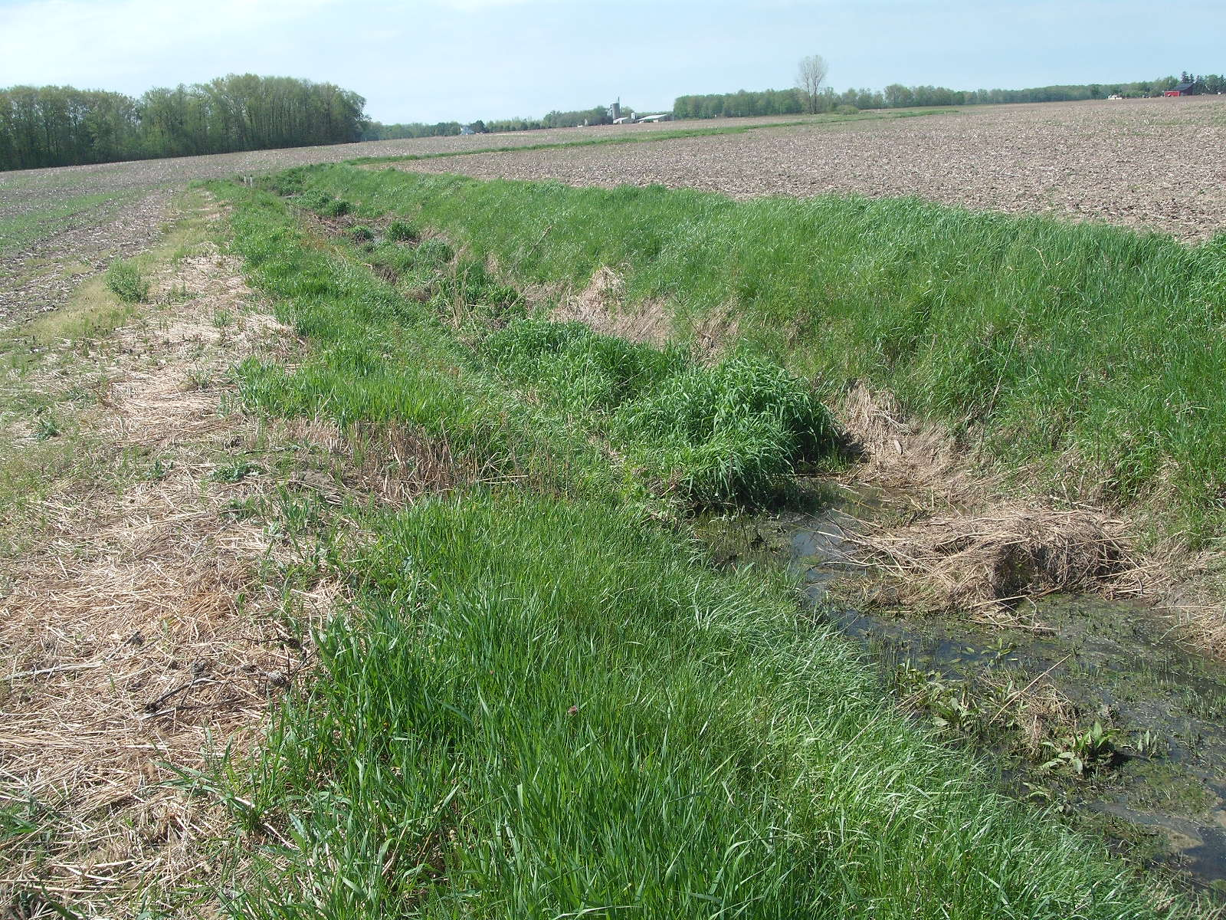

Slide 51
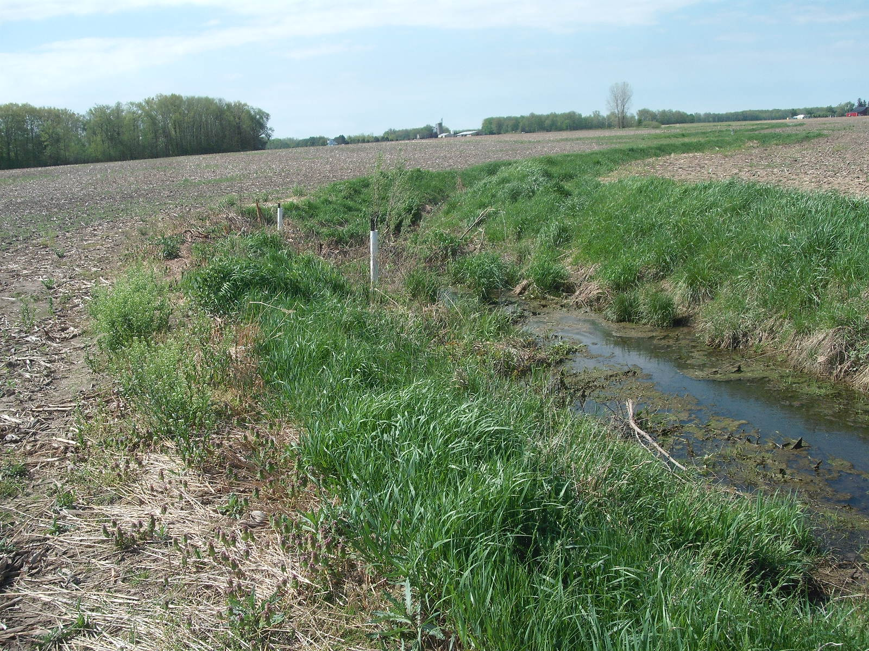

Slide 52
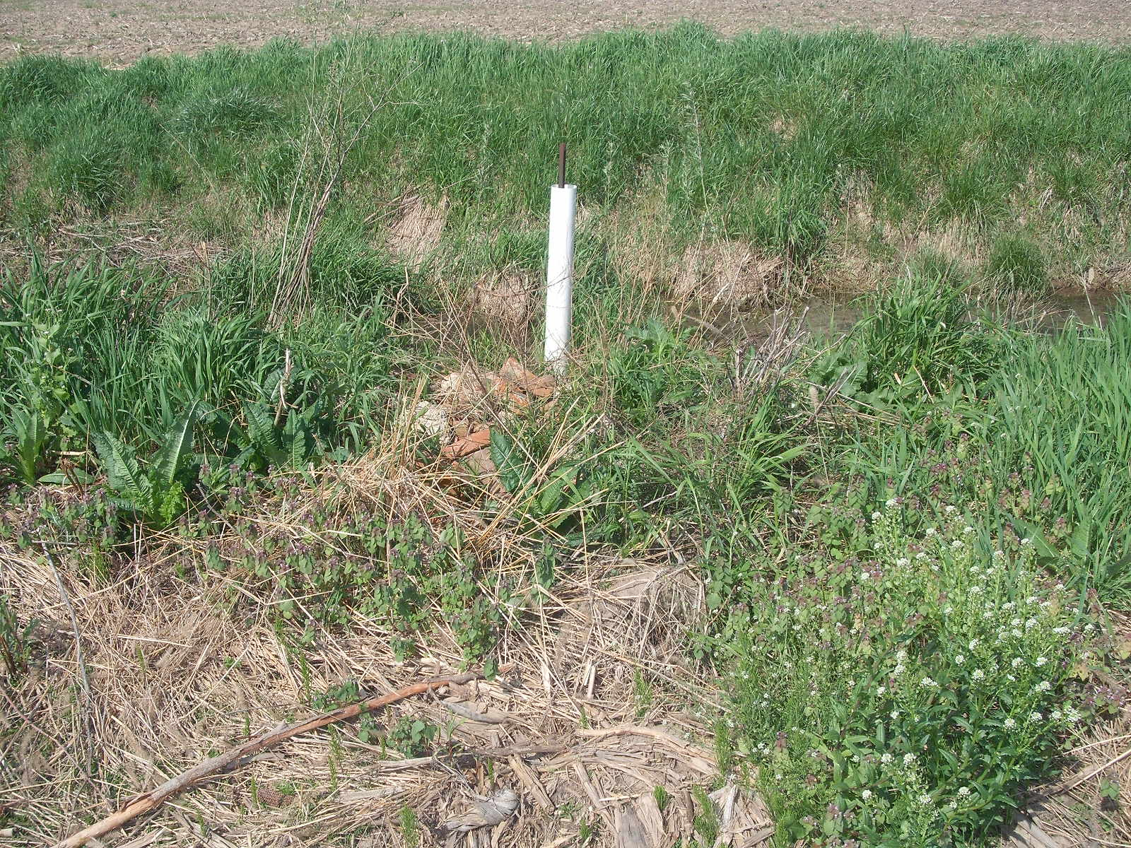

Slide 53
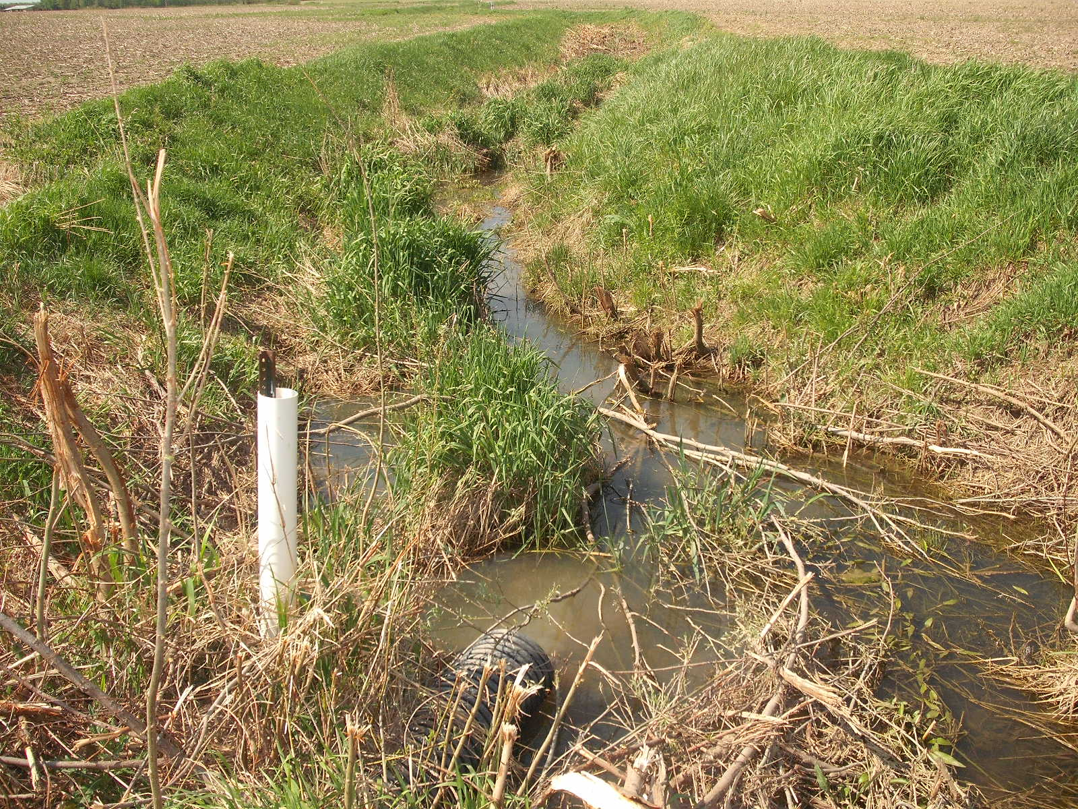

Slide 54
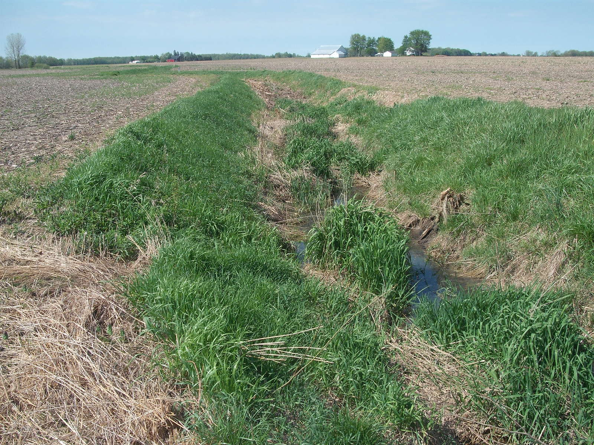

Slide 55
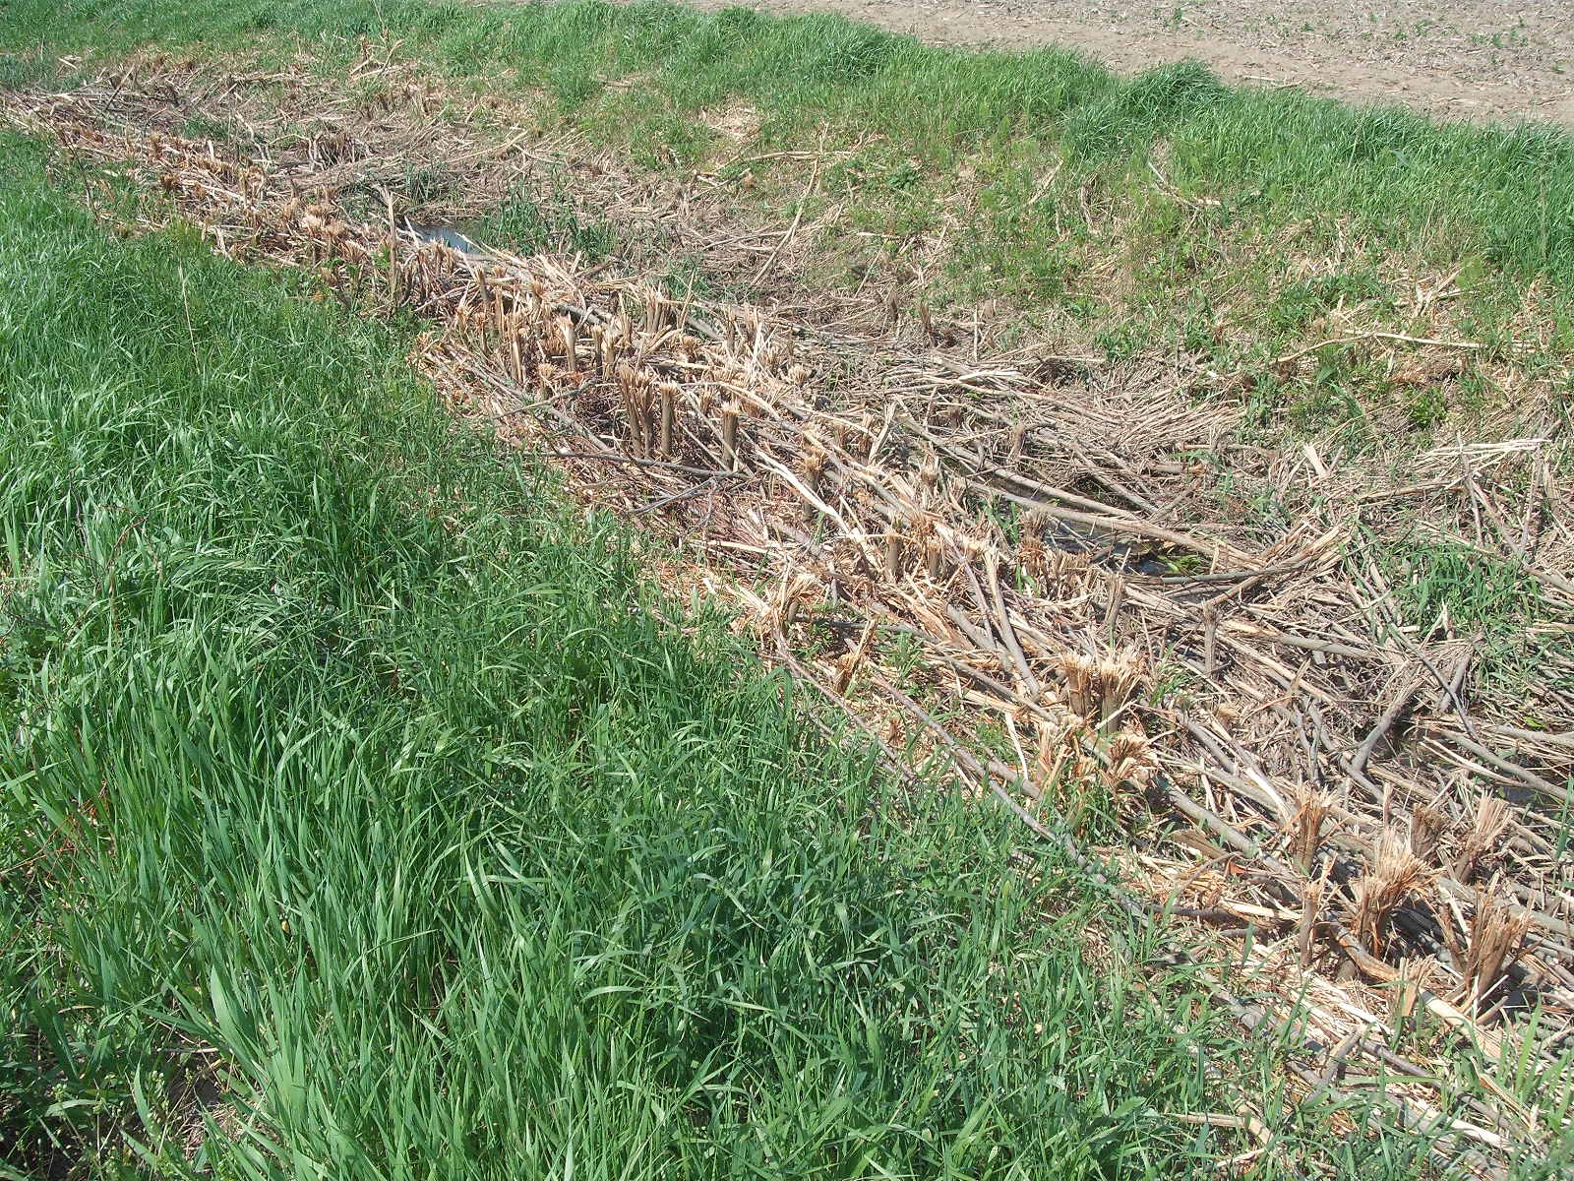

Slide 56
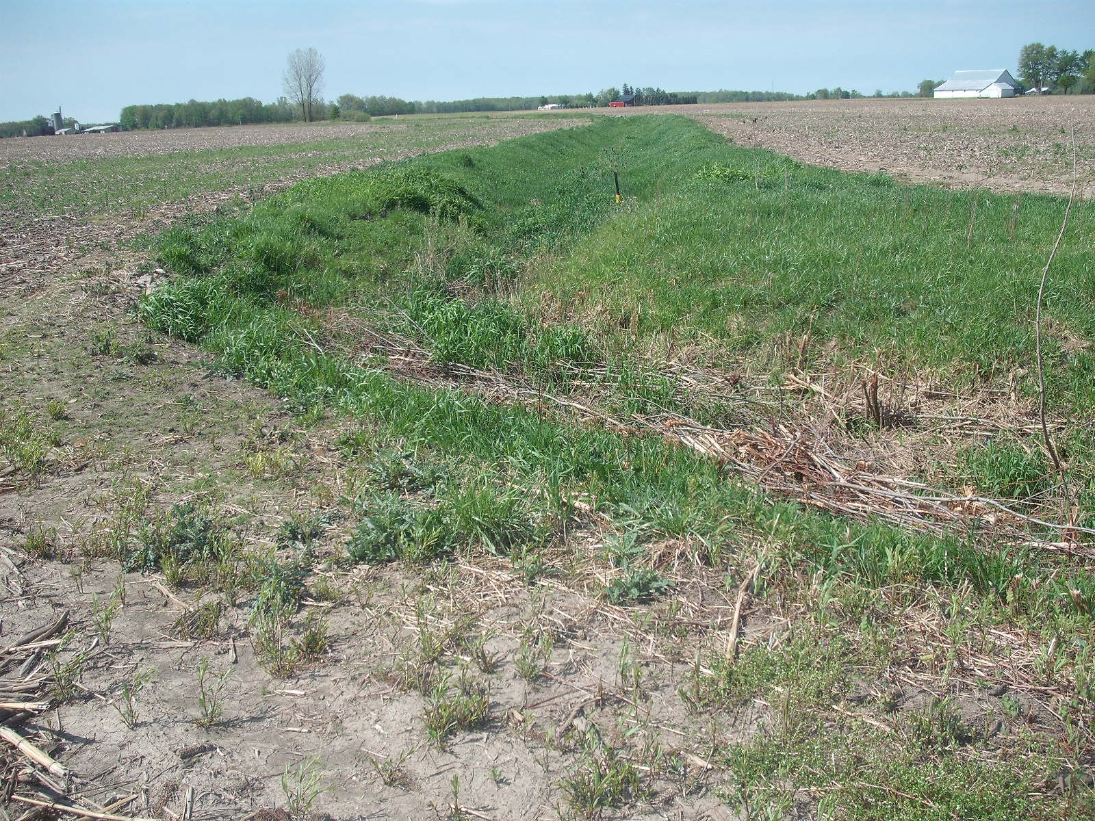

Slide 57
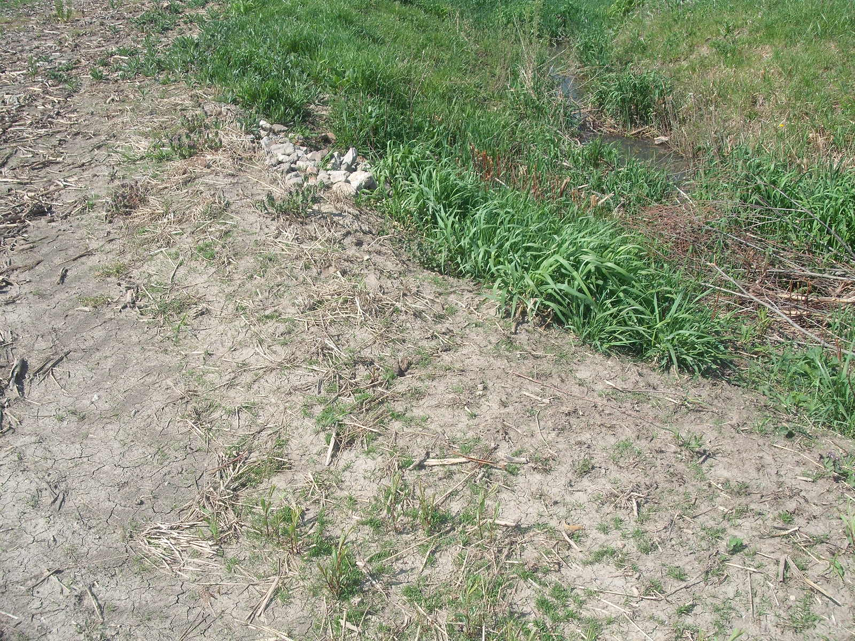

Slide 58


Slide 59


Slide 60


Slide 61


Slide 62


Slide 63


Slide 64
Branch 9 Brush Creek Center Section to US 20A
Section 12, T-7-N, R-5-E, German Township

Slide 66


Slide 67


Slide 68


Slide 69


Slide 70


Slide 71


Slide 72


Slide 73


Slide 74


Slide 75
Branch 9 Brush Creek US20A to Brush Creek Main
Section 13, T7-N, R-5-E, German Township

Slide 77


Slide 78


Slide 79


Slide 80


Slide 81


Slide 82


Slide 83


Slide 84
Branch 9 Brush Creek Branch 9 at Brush Creek Main
Lower Terminus Ditch No. 2152
Section 13, T-7-N, R-5-E, German Township

Slide 85


Slide 86


Slide 87
Ditch No. 2152 Branch 9 Brush Creek
Ditch Viewing May 30, 2024 at 9:30 A.M.
Commissioners Office
Administration Building
Wauseon, Ohio

