Slide 1
Ditch No. 2147
Branch 7e Ai Creek Tile
June 2022

Slide 2
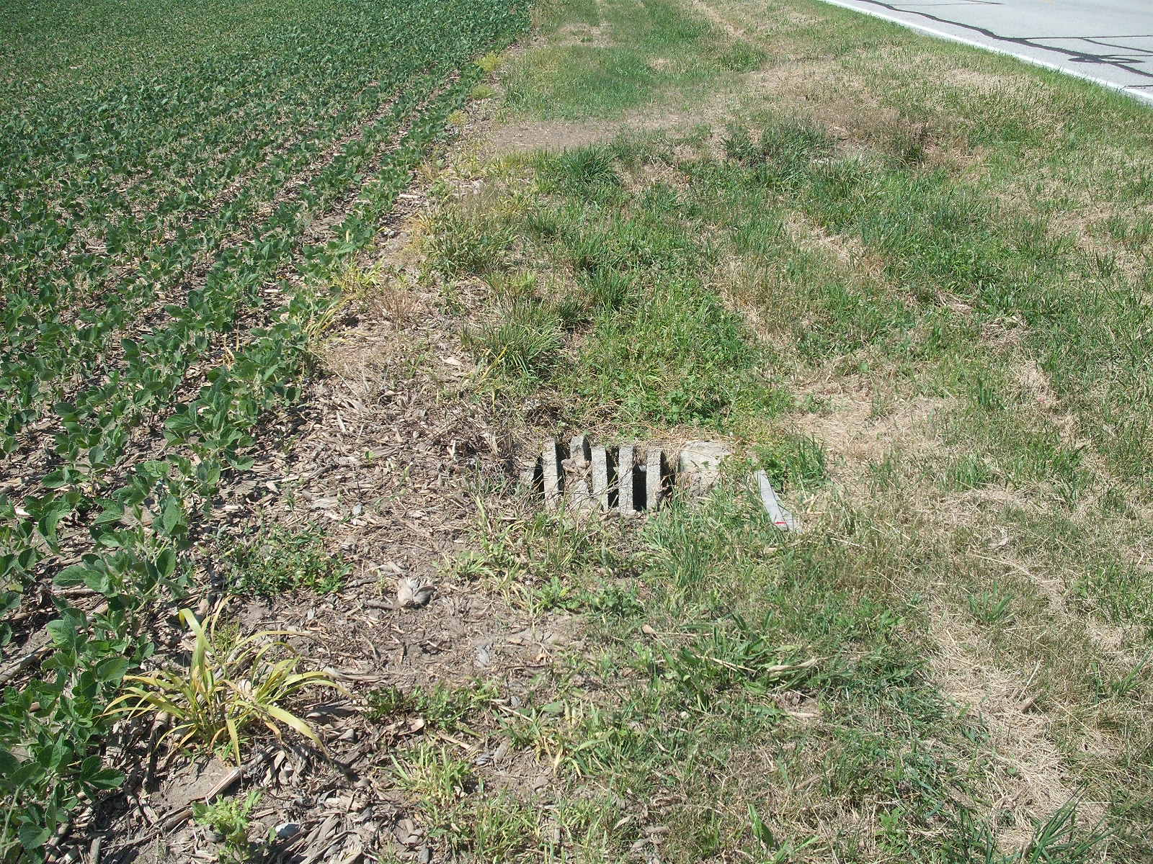
UPPER TERMINUS AT CATCH BASIN 2500 FEET NORTH OF COUNTY ROAD N WEST SIDE ROAD 4-3

Slide 3
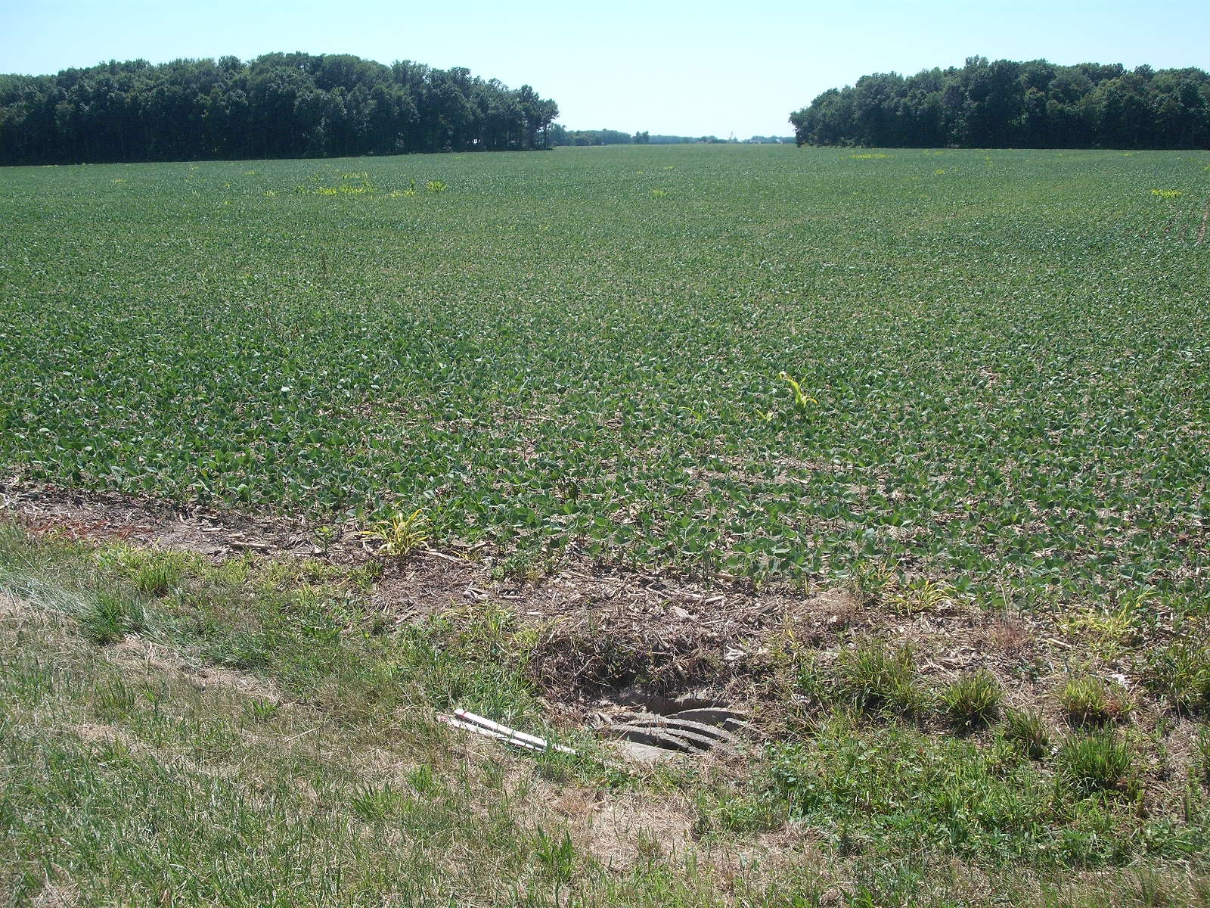
UPPER TERMINUS LOOKING UPSTREAM

Slide 4
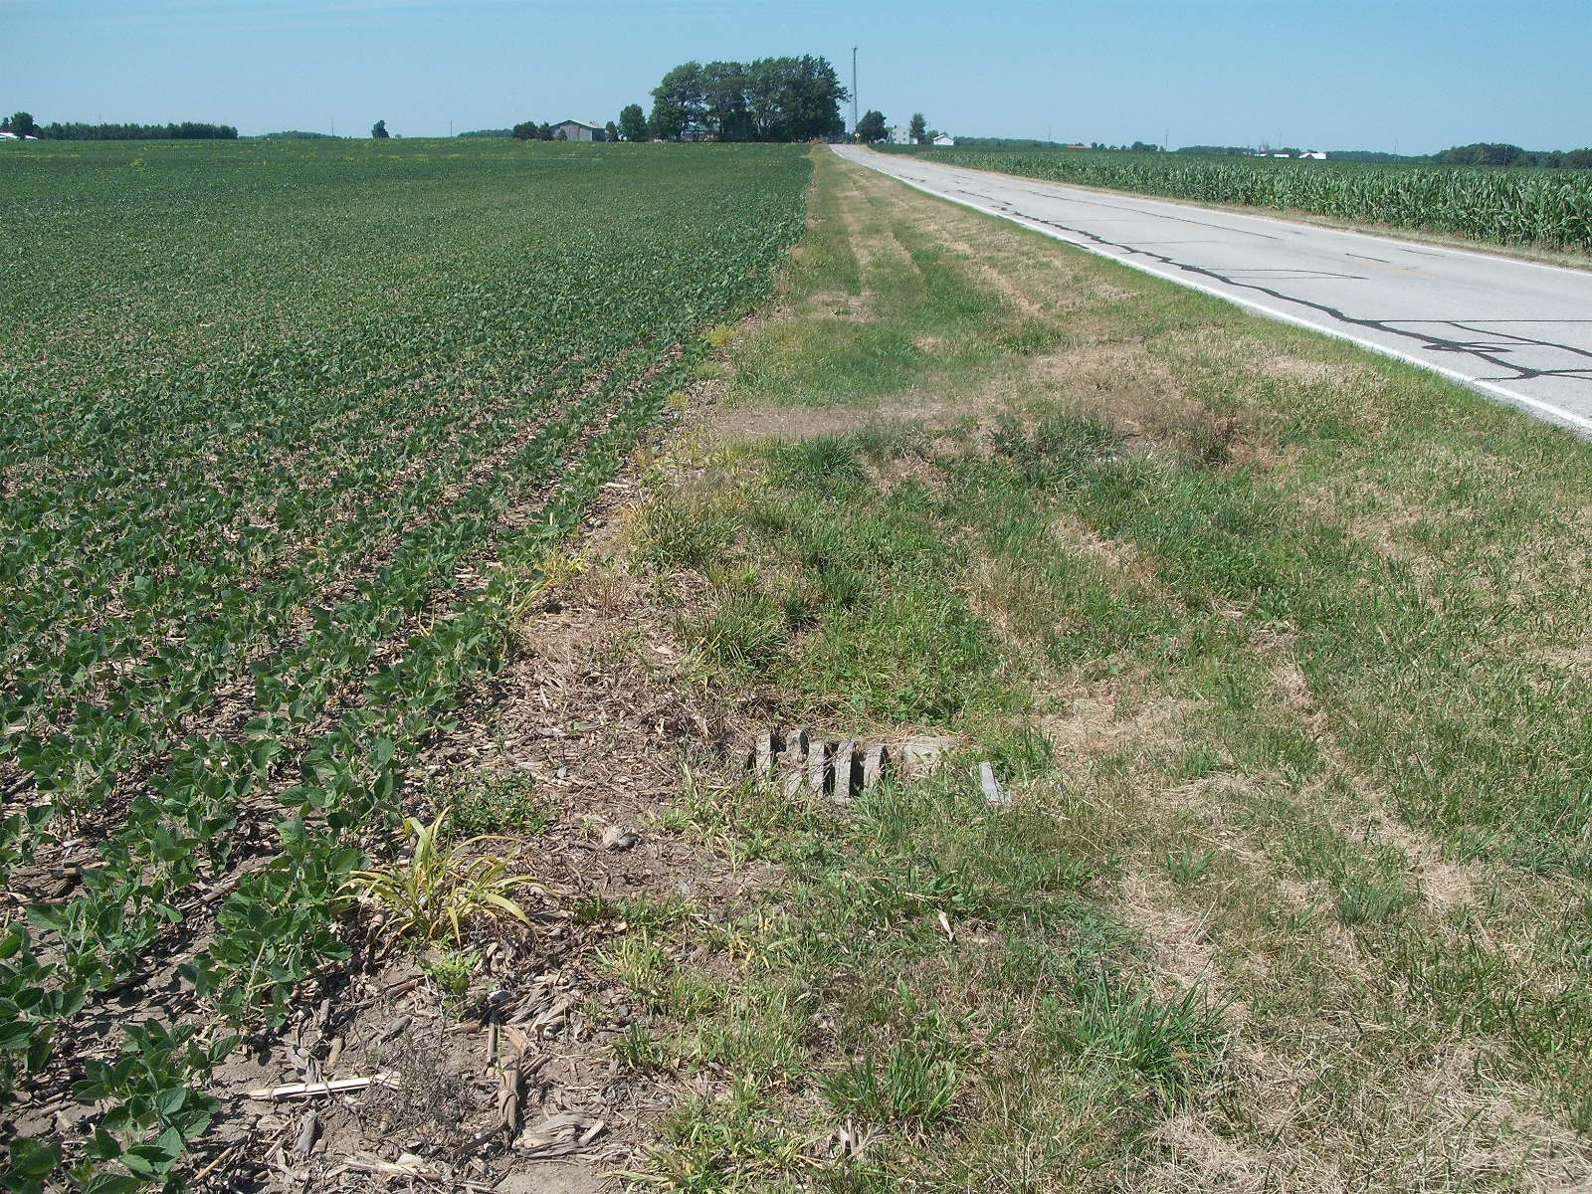
UPPER TERMINUS LOOKING DOWNSTREAM

Slide 5
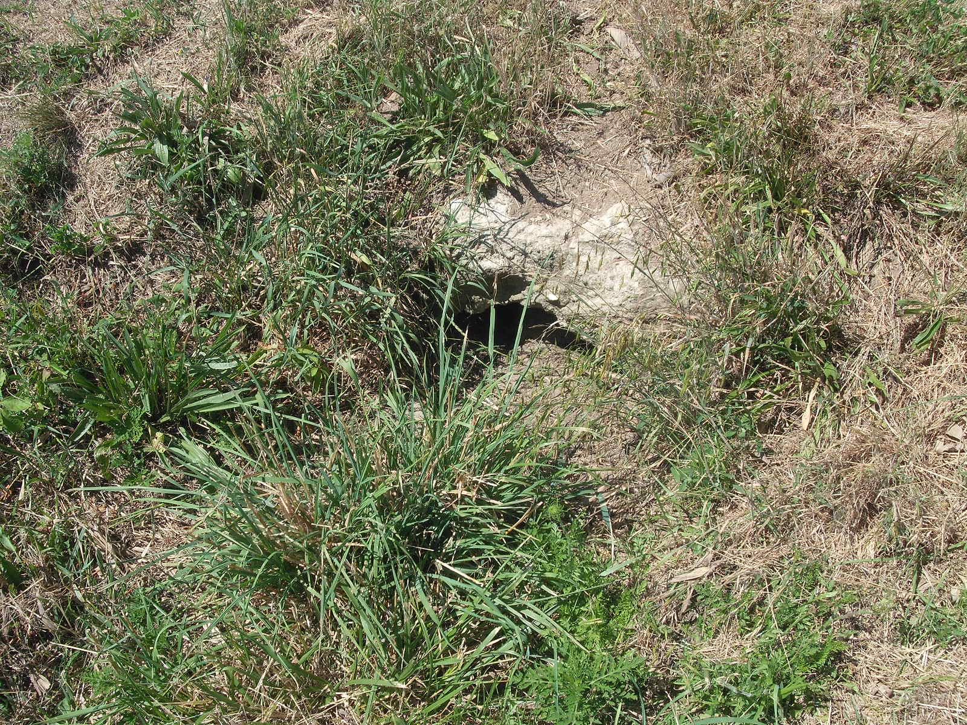
INLET DOWNSTREAM FIELD DRIVE

Slide 6
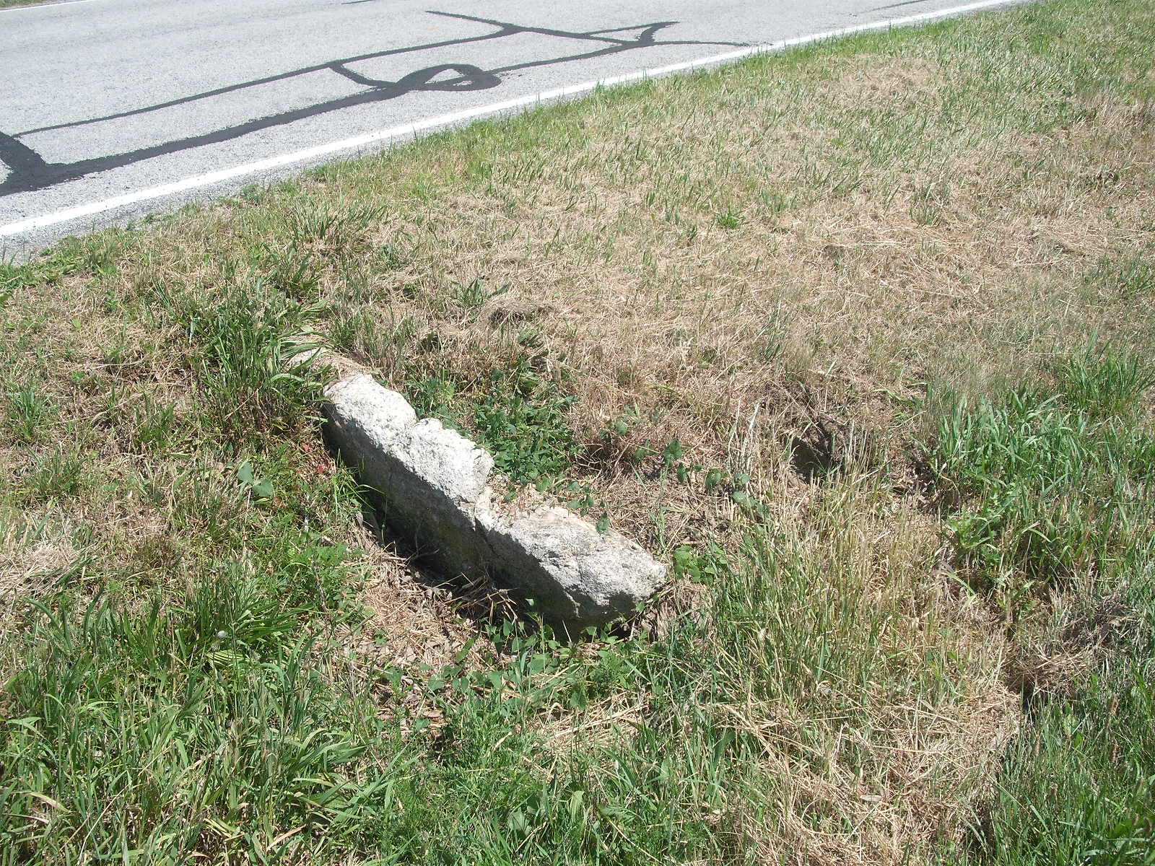
OUTLET DOWNSTREAM FIELD DRIVE

Slide 7
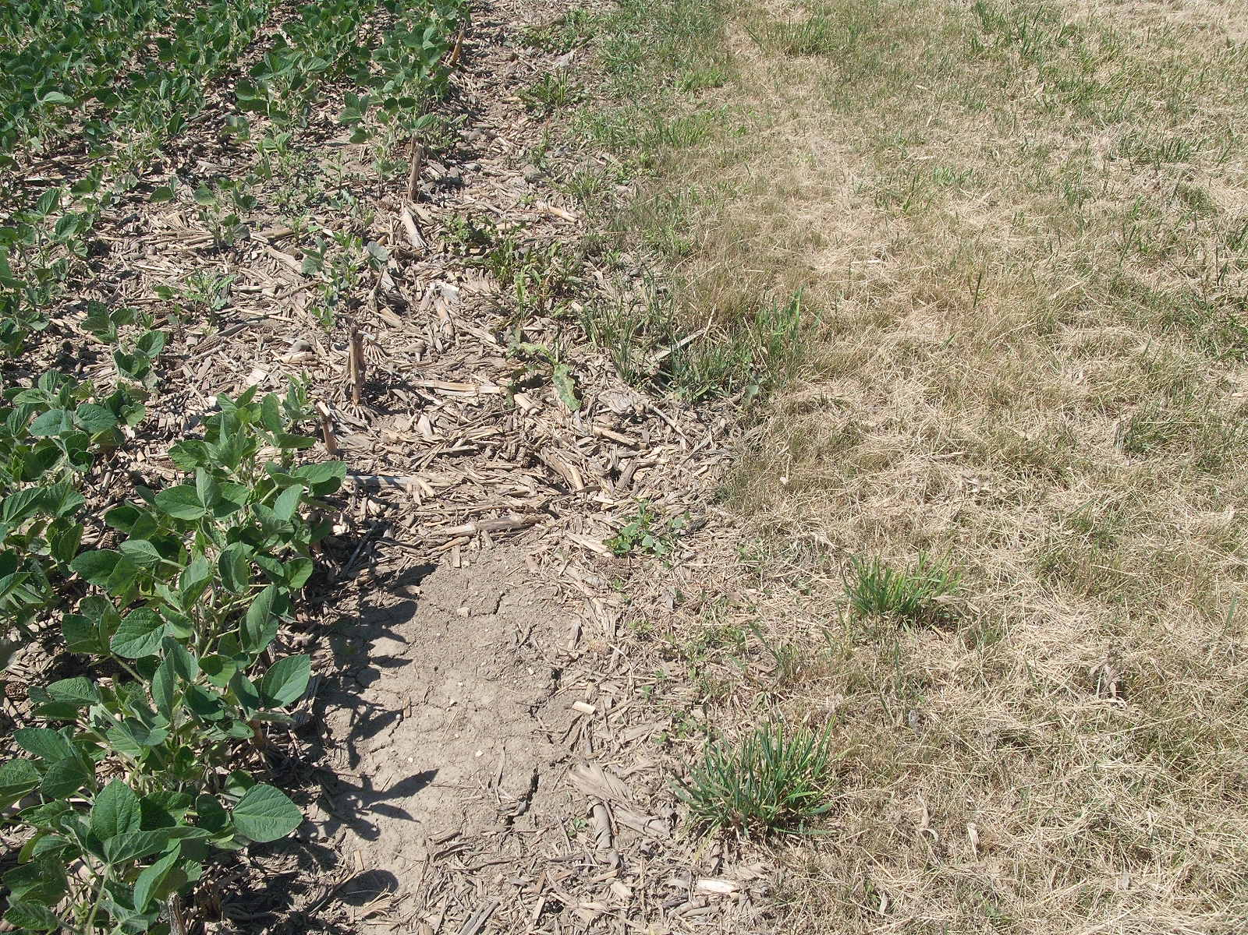
WASHOUT OVER EXISTING MAIN

Slide 8
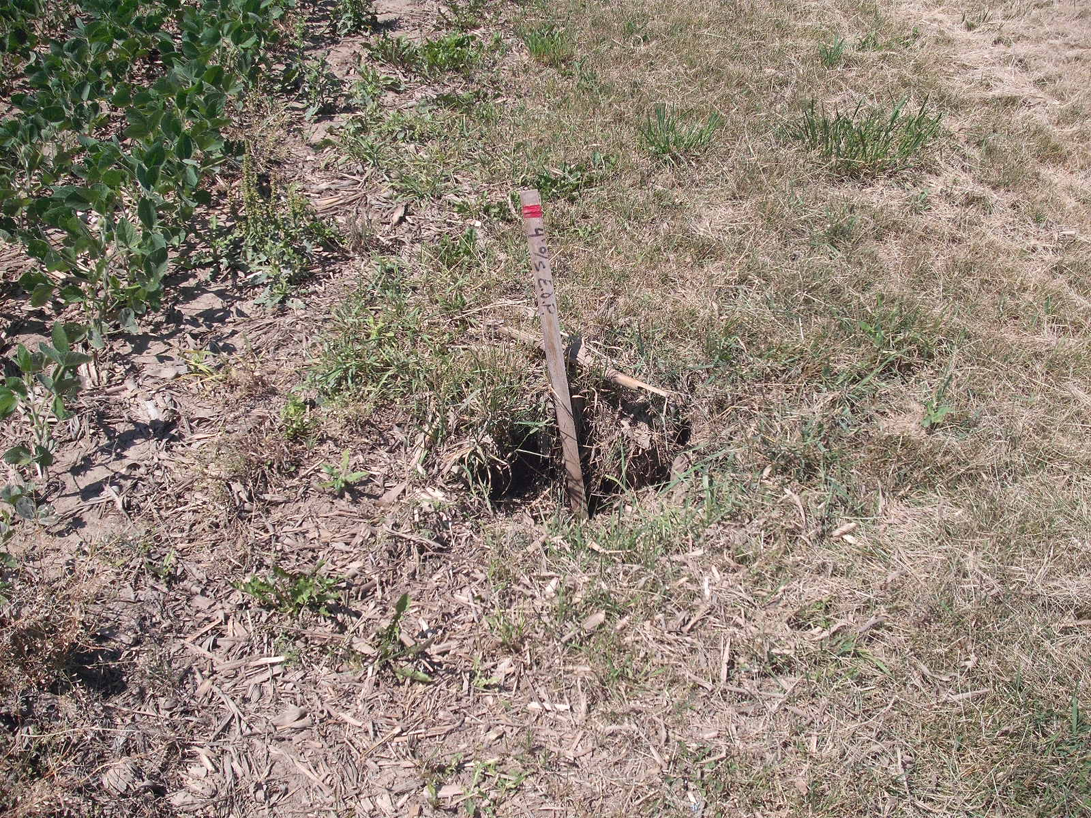
WASHOUT OVER EXISTING MAIN

Slide 9
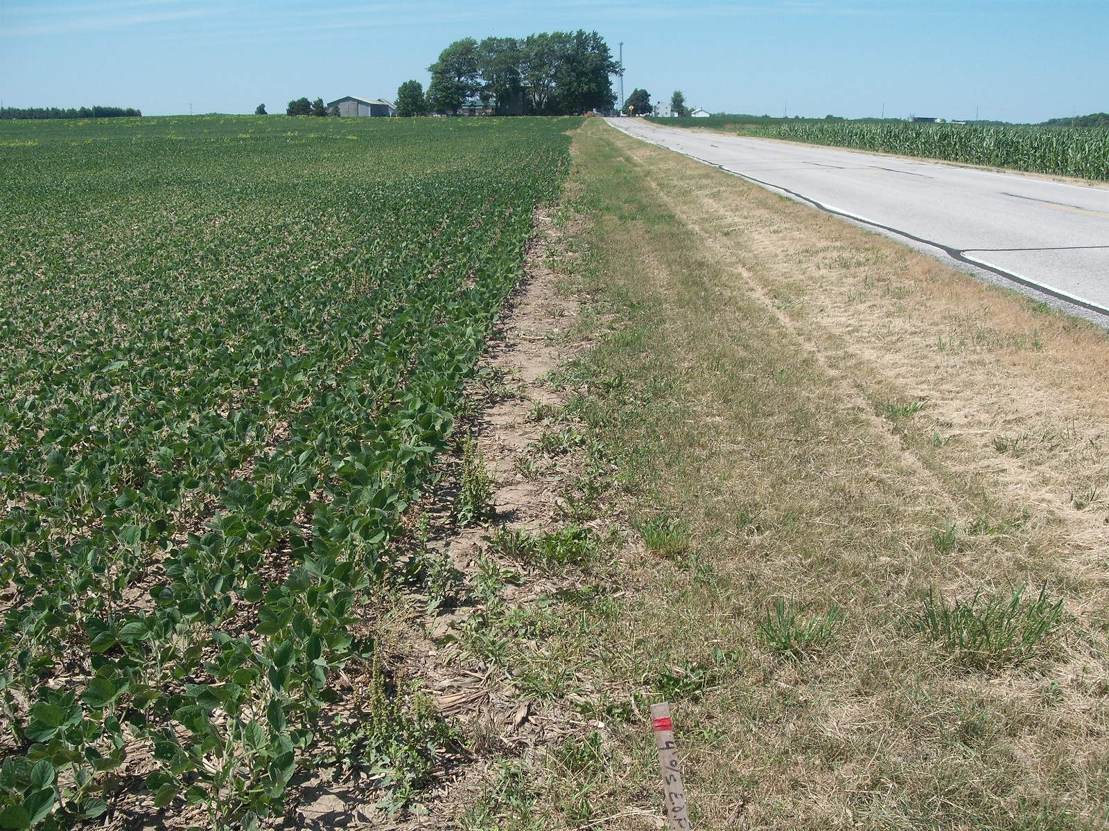
OVER EXISTING MAIN LOOKING DOWNSTREAM

Slide 10
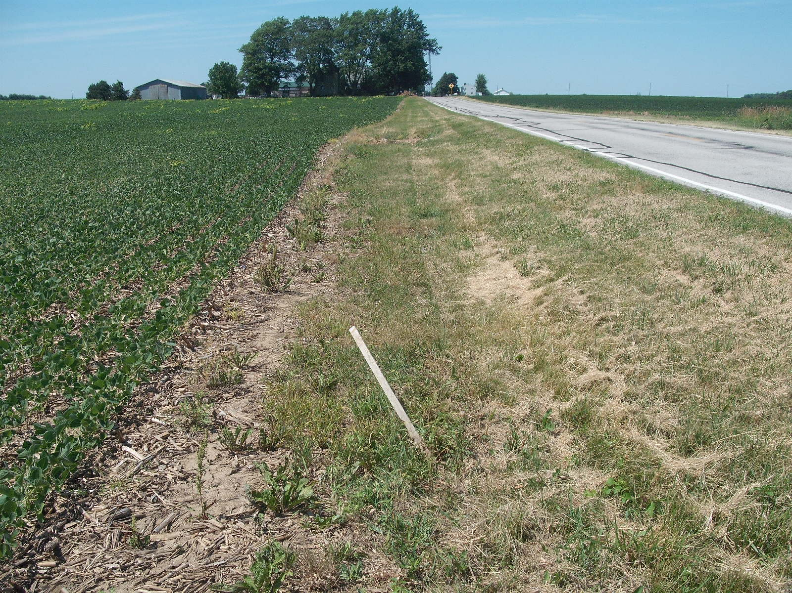
WASHOUT OVER EXISTING MAIN

Slide 11
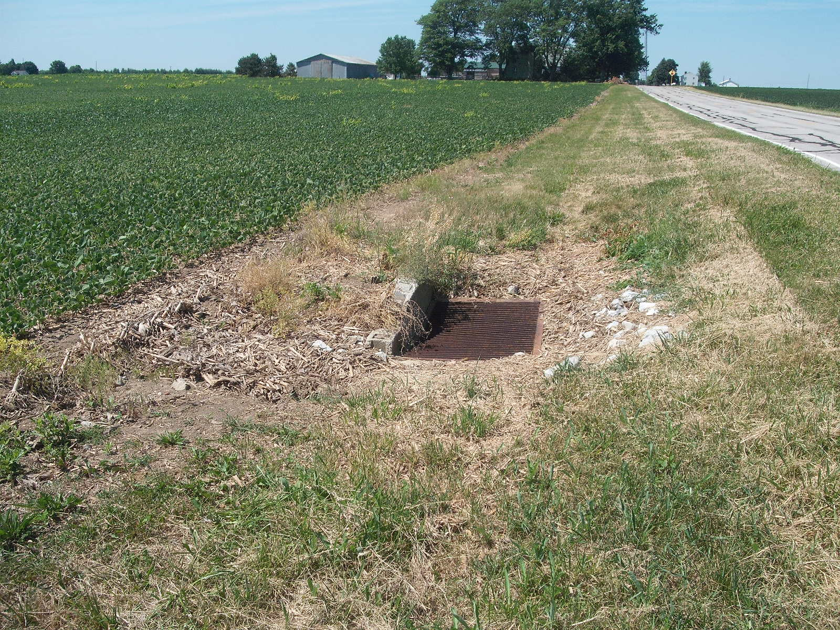
LOWER TERMINUS AT CATCH BASIN

Slide 12
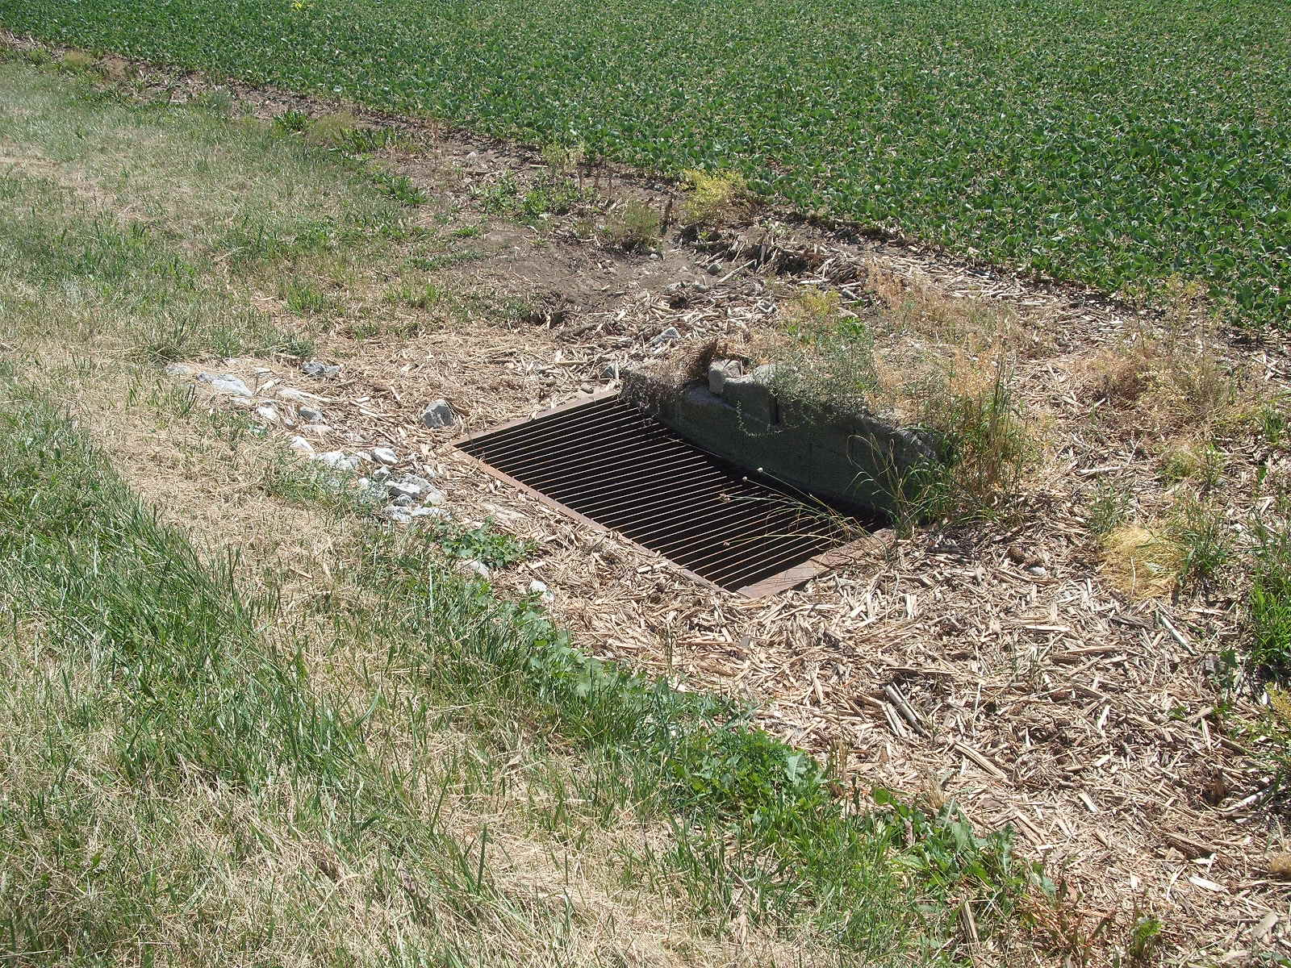
LOWER TERMINUS CATCH BASIN

Slide 13
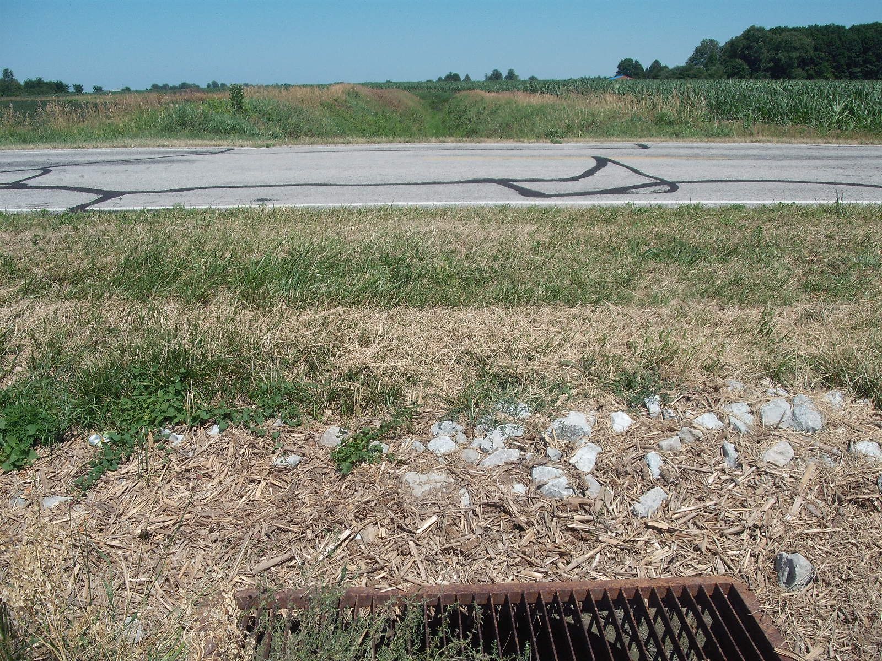
OVER 48-INCH CULVERT THROUGH ROAD 4-3

Slide 14
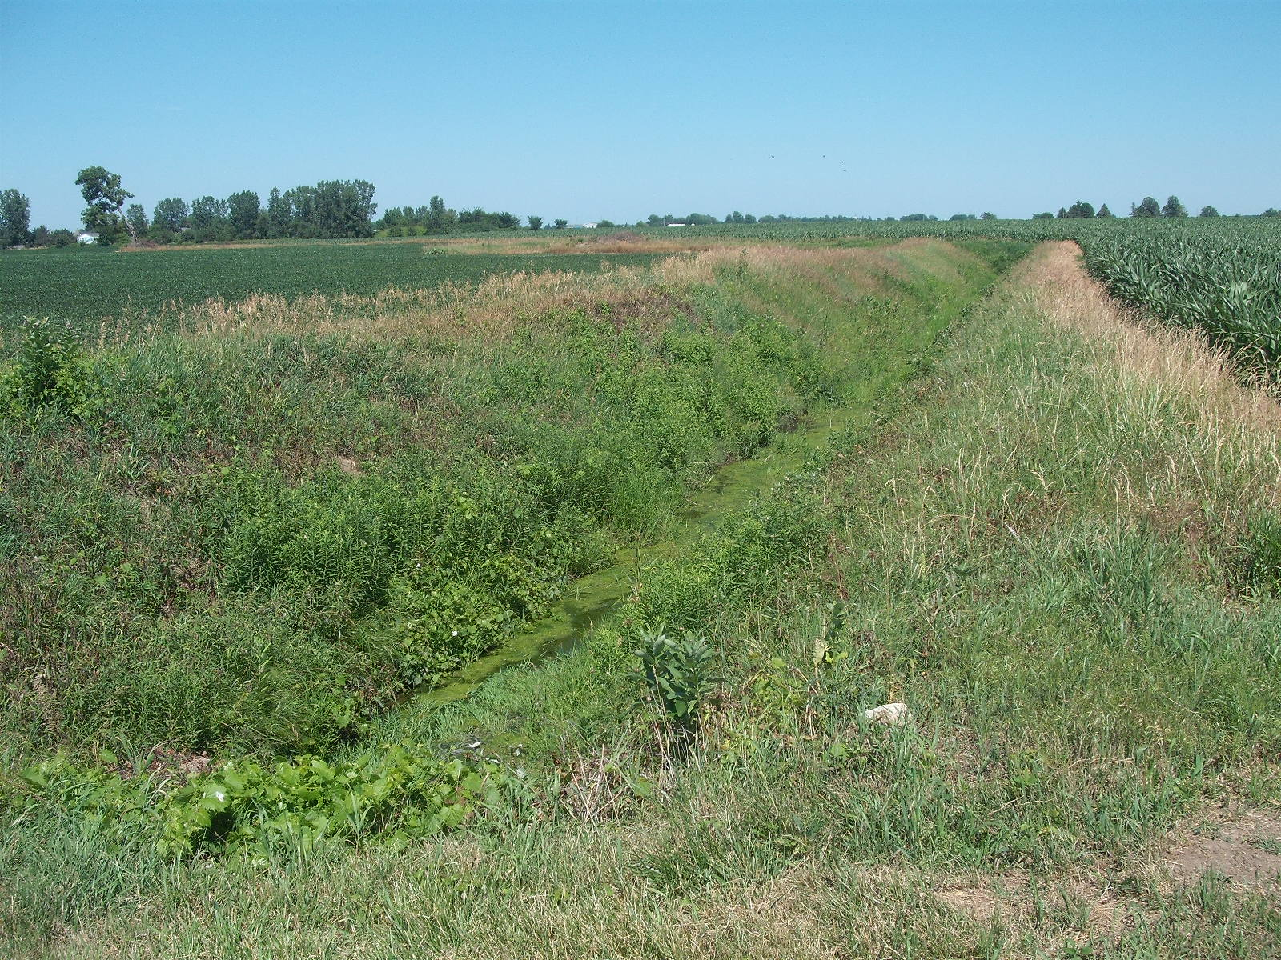
OUTLET DITCH BR. 7e AI CREEK
DITCH NO. 2003

